Slide 1


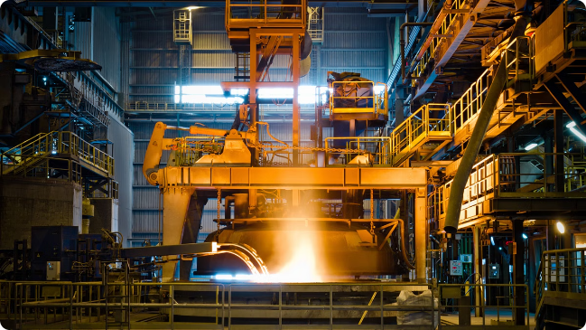

Optimizing Steel Manufacturing: Charge Composition and Energy Use
The leading steel manufacturing company is facing challenges due to variability in material mix and power consumption, which significantly impacts product quality, production efficiency, and operational costs
by pramod nemagouda

Slide 2
CONTENTS
INTRODUCTION
BUSINESS PROBLEM
BUSINESS OBJECTIVE
BUSINESS CONSTRAIN
PROJECT ARCHITECTURE
CRISP-ML(Q) METHODOLOGY
TECHNICAL STACKS
DATA COLLECTION AND UNDERSTANDING
DATA DICTIONARY
EDA IN PYTHON AND SQL
MISSING VALUES OBSERVATION
DATA PREPROCESSING
DATA VISUALIZATION
FUTURE SCOPE
CONCLUSION
THANKYOU

Slide 3
INTRODUCTION
Industry Context: Steel manufacturing is critical to various sectors, but faces challenges in maintaining efficiency and quality
Company Overview: The leading steel manufacturer in focus has a reputation for high-quality products but struggles with operational inefficiencies.
Current Challenges: Variability in material mix and power consumption leads to inconsistent product quality and increased costs.
Objective: To optimize charge composition and energy use for better efficiency, cost savings, and consistent product quality.
Importance of Optimization: Enhancing production processes can significantly impact profitability and competitive advantage.
Project Scope: This initiative targets the manufacturing department, focusing on improving raw material and power usages.
Expected Outcomes: The project aims to boost production efficiency by 20% and reduce energy consumption by 15%, leading to substantial cost savings

Slide 4
BUSINESS PROBLEM
Maximize product quality and production efficiency.
The company struggles with variability in material mix and power consumption, impacting product quality. Identifying the optimal charge mix and power usage will improve efficiency, reduce costs, and ensure consistent quality..

Slide 5
BUSINESS OBJECTIVE
Minimize power consumption while achieving production targets.
Maintain quality standards despite changes in material and power usage.

Slide 6
BUSINESS CONSTRAIN
Maximize power consumption 2 points
Optimize Equipment Utilization: Ensure that all machinery and equipment operate at their highest efficiency
levels, minimizing downtime and reducing energy wastage. Implement Energy Recovery Systems: Utilize technologies that can capture and reuse waste energy
generated during production processes.

Slide 7
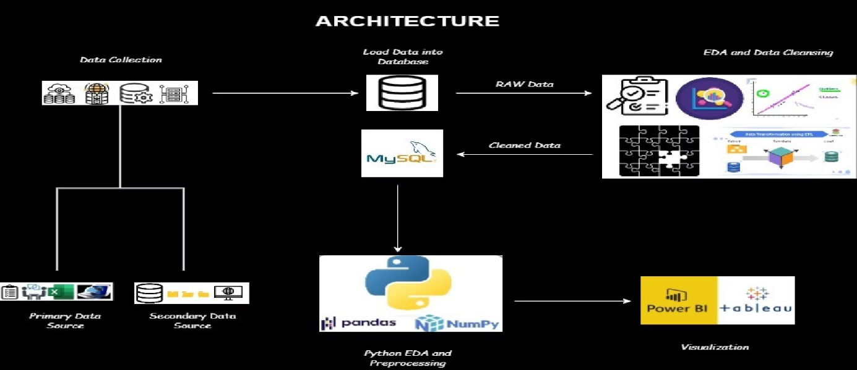
PROJECT ARCHITECTURE

Slide 8
PROJECT ARCHITECTURE
• In the Project Architecture, we start by gathering a deep understanding of both business
needs and available data.
• Once we have a clear picture, we collect the necessary data for analysis.
• The data is then transformed to SQL for initial EDA and data pre-processing.
• Then we transform the data into Python for further EDA and pre-processing, to unfold its
powerful analytical opportunities.
• Once the data is thoroughly cleaned and prepared, we transfer it to Power BI to create
interactive dashboards.
• These dashboards, showcasing the insights driven from the data, are then submited to the
client for review and decision making.

Slide 9
CRISP-ML(Q) METHODOLOGY
• In accordance with CRISP-ML(Q)methodology, the project primarily focused on two key
stages, they are :
• BUSINESS AND DATA UNDERSTANDING
• DATA PREPARATION
• These stages involved gaining insights into business requirement and understanding the
data sources, followed by preparing the data for analysis through cleaning and
preprocessing techniques.

Slide 10
TECHNICAL STACKS
• The technical stacks utilised in the project included Python and SQL for data analysis and
manupulation, along with Power BI for creating interactive dashboards to visualize the
insights derived from the data.

Slide 11
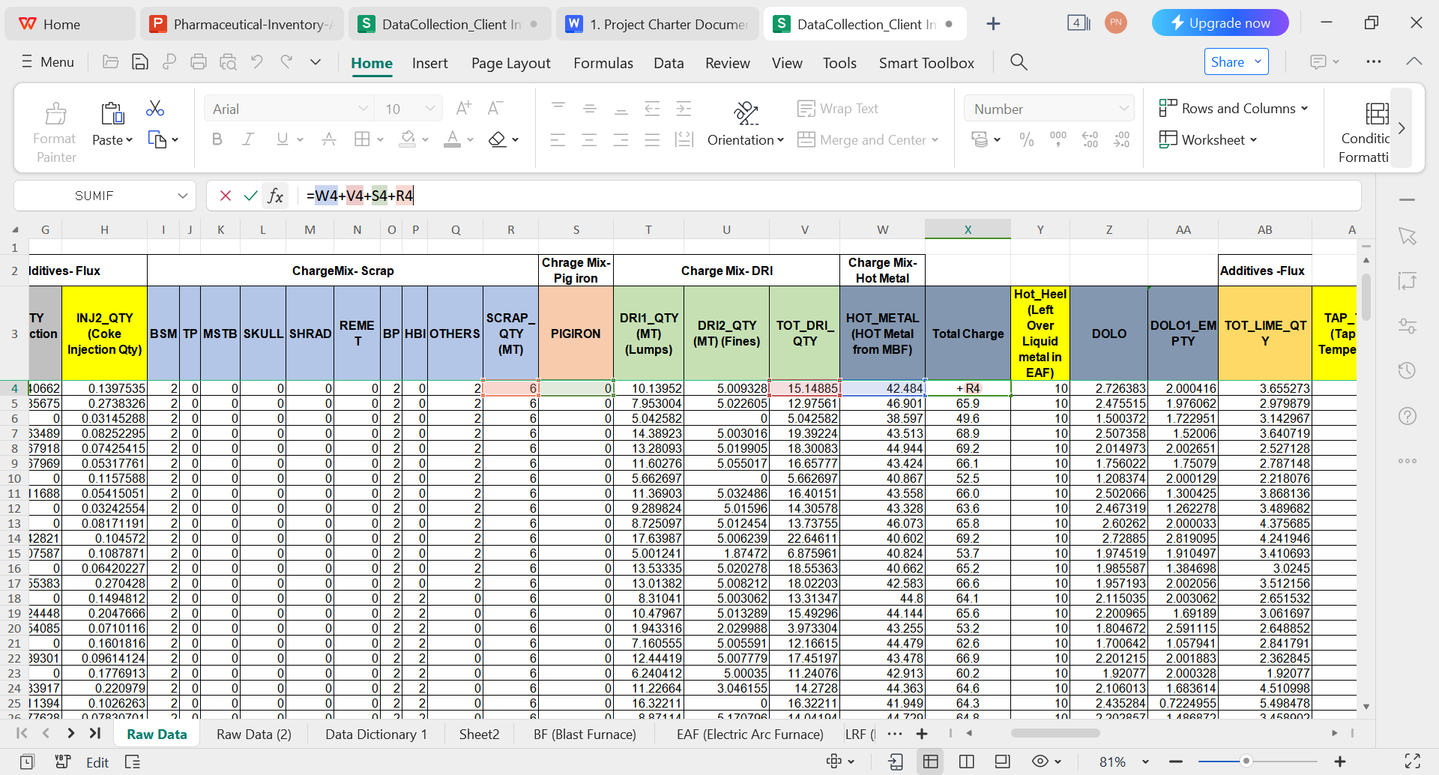
DATA COLLECTION AND UNDERSTANDING
The dataset was obtained from the client and is structured, containing 79 columns : SRNO,DATETIME,HEATNO,GRADE,SECTION_IC,COKE_REQ,"INJ1_QTY (Coke Injection Qty)","INJ2_QTY (Coke Injection Qty)",BSM,TP,MSTB,SKULL,SHRAD,REMET,BP,HBI,OTHERS,SCRAP_QTY (MT),PIGIRON,DRI1_QTY (MT) (Lumps),"DRI2_QTY (MT) (Fines)",TOT_DRI_QTY,HOT_METAL (HOT Metal from MBF),Total Charge,Hot_Heel (Left Over Liquid metal in EAF),DOLO,DOLO1_EMPTY,TOT_LIME_QTY,TAP_TEMP (Tappnig Temperature),O2REQ,O2ACT,ENERGY (Energy Consumption),KWH_PER_TON (Energy Consumption Per Ton),KWH_PER_MIN,MELT_TIME (Melting Time),TA_TIME (Turn Around Time),TT_TIME (Total Cycle Time Including Breakdown),POW_ON_TIME,TAPPING_TIME,ARCING_TIME,DOWN_TIME,E1_CUR (Electrode 1 Current),E2_CUR (Electrode 2 Current),E3_CUR (Electrode 3 Current),SPOUT (Bottom Refractory Temperature),DOLOMIT,CPC,TEMPERATURE,POWER,LAB_REP_TIME,C,SI,MN,P,S,CU,CR,NI,N,TIME_UTLN_PRCNT,TOP_COKE,OPEN_C,TAP_C,IT_KG,BUCKET_NO,STATIC_WT,LIME,LIME2,O2SIDE1,O2SIDE2,O2SIDE3,SPINNING,RAMMING1,RAMMING2,PREV_TAP_TIME,TAP_DURATION,Pour_Back_Metal,LM_WT,Production (MT)

Slide 12
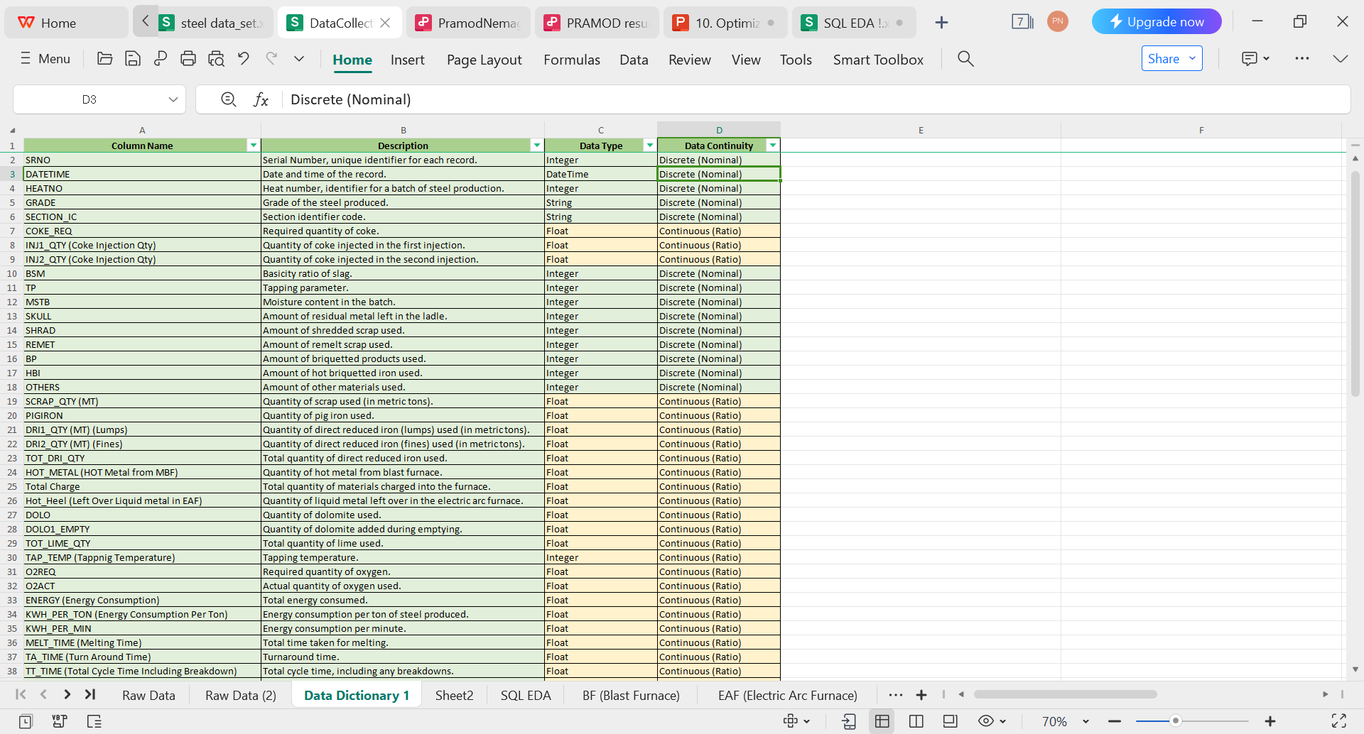
DATA DICTIONAR

Slide 13
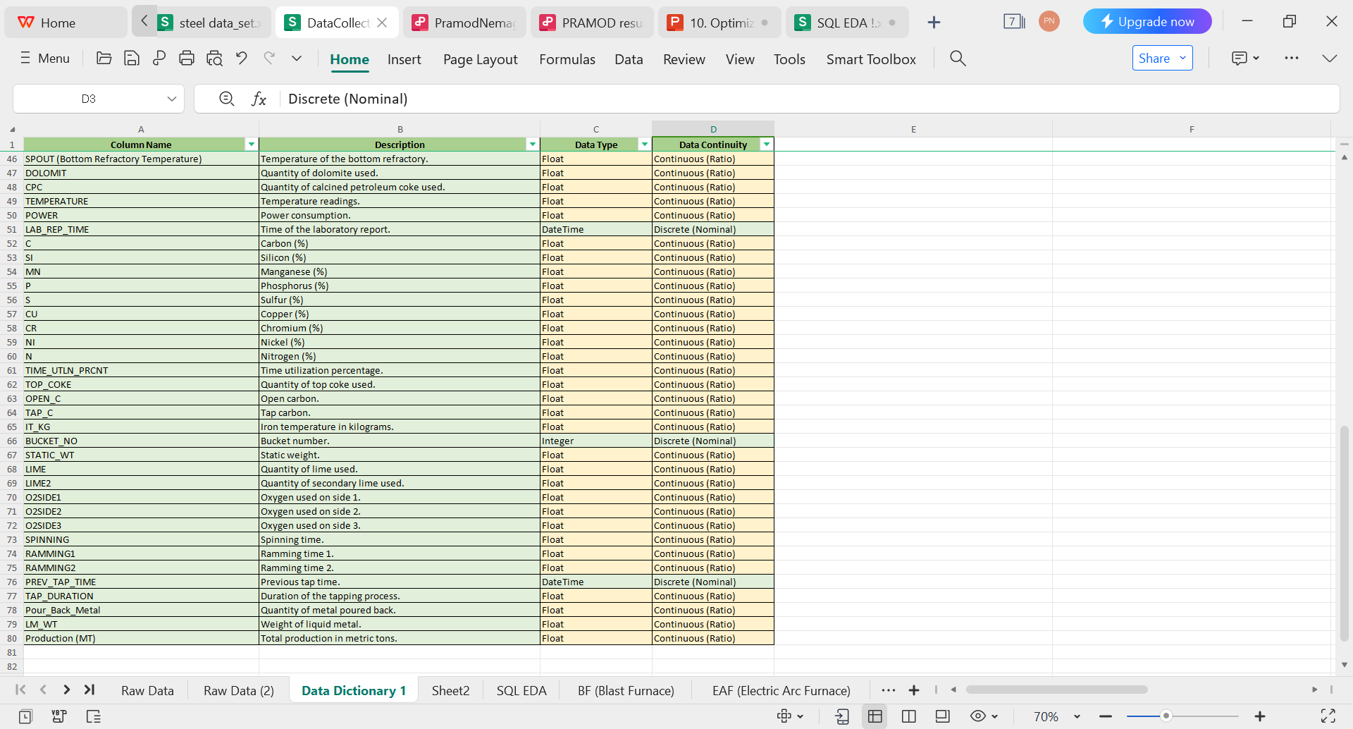
DATA DICTIONAR

Slide 14
Business Insights & Statistical insights
PIGIRON | Pig iron | 0.0811 | 0 | 0 | 0.547574102 | 0.739982501 | 12 | 13.073961 | 196.6317175 | Extremely high skewness (13.07) and very high kurtosis (196.63) indicate extreme outliers. | The low mean and extremely high skewness and kurtosis suggest minimal but highly variable usage of pig iron. This highlights the need for better inventory management and monitoring to ensure consistent quality.
DRI1_QTY (MT) (Lumps) | Quantity of Direct Reduced Iron (DRI) in metric tons (lumps) | 9.699181479 | 9.529 | 10.13952 | 16.04235357 | 4.005290698 | 37.44913 | 0.539654427 | 1.699183351 | Moderate skewness (0.54) and positive kurtosis (1.70) suggest presence of outliers. | The moderate mean and slight positive skewness suggest consistent usage of DRI, indicating an efficient process. The low kurtosis suggests occasional variations that need monitoring to maintain optimal conditions.
TOT_DRI_QTY | Total DRI quantity | 14.66379142 | 14.87 | 15.14885 | 16.99655679 | 4.122688054 | 37.44913 | -0.19529893 | 1.077410746 | Negative skewness (-0.20) and positive kurtosis (1.08) suggest slight left-tailed distribution. | The moderate mean and near-zero skewness suggest consistent total DRI usage, indicating a stable process. The low kurtosis suggests occasional variations that need monitoring to maintain optimal conditions.
HOT_METAL (HOT Metal from MBF) | Hot metal from the Midrex process | 43.46996406 | 43.94 | 42.484 | 17.70791676 | 4.208077561 | 55.36 | -3.957302807 | 31.8070177 | Negative skewness (-3.96) and very high kurtosis (31.81) indicate significant variability. | The high mean and extremely negative skewness suggest consistent high usage of hot metal from the Midrex process. The extreme kurtosis highlights rare but extreme low values, requiring careful monitoring to maintain process stability.
Total Charge | Total weight of materials charged to the furnace | 66.176009 | 66.05 | 63.63285 | 39.04172652 | 6.2483379 | 61.623777 | 0.509610416 | 5.576259286 | Moderate skewness (0.51) and high kurtosis (5.58) indicate some variability. | The high mean and slight positive skewness suggest consistent high material usage, indicating an efficient process. The moderate kurtosis suggests occasional variations that need monitoring to maintain optimal conditions.
Hot_Heel (Left Over Liquid metal in EAF) | Leftover molten metal in the Electric Arc Furnace (EAF) | 10.08572122 | 10 | 10 | 2.643331813 | 1.625832652 | 16 | 0.398436849 | 5.31829889 | Moderate skewness (0.40) and high kurtosis (5.32) suggest some variability and outliers. | The moderate mean and slight positive skewness suggest occasional leftover molten metal, indicating potential for process optimization to reduce waste. The moderate kurtosis highlights occasional variations that need monitoring.
DOLO | Dolomite - refractory lining material | 1.884902954 | 1.923 | 2.726383 | 0.254149107 | 0.504132034 | 3.436178 | -0.419657518 | 0.776455824 | Negative skewness (-0.42) and positive kurtosis (0.78) suggest slight left-tailed distribution. | The moderate mean and slight negative skewness suggest consistent usage of dolomite, indicating an efficient process. The low kurtosis suggests occasional variations that need monitoring to maintain optimal conditions.
DOLO1_EMPTY | Weight of empty Dolomite | 1.647235037 | 1.554 | 2.000416 | 0.266048575 | 0.515798968 | 5.14685 | 0.776781668 | 2.357471905 | Moderate skewness (0.78) and positive kurtosis (2.36) indicate presence of outliers. | The moderate mean and positive skewness suggest consistent usage of empty dolomite, indicating an efficient process. The moderate kurtosis suggests occasional variations that need monitoring to maintain optimal conditions.
TOT_LIME_QTY | Total quantity of lime | 2.909546938 | 2.921 | 3.655273 | 0.540757949 | 0.735362461 | 6.008399 | -0.057670087 | 0.54120583 | Nearly symmetric distribution with very low skewness (-0.06) and kurtosis (0.54). | The moderate mean and near-zero skewness suggest consistent lime usage, indicating an efficient process. The low kurtosis suggests occasional variations that need monitoring to maintain optimal conditions.
TAP_TEMP (Tappnig Temperature) | Temperature at which the molten metal is tapped from the furnace | 1643.3963 | 1634 | 1627 | 112017.7633 | 334.6905486 | 6554 | 11.50990529 | 180.7626204 | Very high skewness (11.51) and extremely high kurtosis (180.76) indicate extreme outliers. | The high mean and extremely high skewness suggest significant variations in tapping temperature, requiring careful monitoring to ensure optimal process conditions and consistent quality. The extreme kurtosis highlights rare but extreme values that need close attention.
O2REQ | Oxygen requirement | 0 | 0 | 0 | 0 | 0 | 0 | NULL | NULL | Data not available for analysis. | All values being 0 suggest no recorded oxygen requirement, which might indicate a data entry issue or non-applicable context. This needs further investigation to ensure accuracy in data recording.
O2ACT | Actual oxygen usage | 562.1885784 | 563.1 | 584.3806 | 7719.646952 | 87.86152146 | 1082.108 | -0.028869444 | 3.543888456 | Nearly symmetric distribution with very low skewness (-0.03) and moderate kurtosis (3.54). | The high mean and slight negative skewness suggest consistent high oxygen usage, indicating an efficient process. The moderate kurtosis suggests occasional variations that need monitoring to maintain optimal conditions.
ENERGY (Energy Consumption) | Total energy consumption | 9988.949562 | 9859 | 10623.58 | 11571574.88 | 3401.701762 | 49078.66 | 2.492319131 | 24.0760338 | High skewness (2.49) and very high kurtosis (24.08) indicate significant variability and outliers. | The extremely high mean and positive skewness suggest significant energy usage, which is expected in steel production. However, the high kurtosis indicates rare but extreme values, requiring careful monitoring to improve energy efficiency and reduce costs.
KWH_PER_TON (Energy Consumption Per Ton) | Energy consumption per ton of steel produced | 151.6788367 | 149.8 | 153.8916 | 2443.299318 | 49.42974123 | 725.0042 | 2.457297423 | 21.72658755 | High skewness (2.46) and very high kurtosis (21.73) indicate significant variability and outliers. | The moderate mean and positive skewness suggest significant energy consumption per ton of steel, indicating the need for process optimization to improve energy efficiency. The high kurtosis highlights rare but extreme values that need close attention.
KWH_PER_MIN | Kilowatt-hours per minute | 3.5765 | -1 | -1 | 1943.528267 | 44.08546549 | 448 | 9.548339291 | 89.33771489 | High skewness (9.55) and very high kurtosis (89.34) indicate extreme variability and outliers. | The moderate mean and extremely high skewness suggest significant variations in energy consumption rate, requiring careful monitoring to improve energy efficiency and reduce costs. The extreme kurtosis highlights rare but extreme values that need close attention.
MELT_TIME (Melting Time) | Time it takes to melt the charge | 42.38967136 | 39.75 | 59.50000001 | 190.0083119 | 13.78435025 | 214.4833333 | 6.860052009 | 70.19475126 | High skewness (6.86) and very high kurtosis (70.19) indicate significant variability and outliers. | The moderate mean and extremely high skewness suggest significant variations in melting time, requiring careful monitoring to improve process efficiency and reduce costs. The extreme kurtosis highlights rare but extreme values that need close attention.
TA_TIME (Turn Around Time) | Time between taps | -42.39773353 | 12.8 | 0 | 8530757.297 | 2920.746017 | 134901.55 | -45.2841642 | 2050.474189 | Very high negative skewness (-45.28) and extremely high kurtosis (2050.47) indicate extreme outliers. | The mean, median, and mode being highly variable suggest significant variations in time between taps, requiring careful monitoring to improve process efficiency and reduce costs. The extremely high skewness and kurtosis highlight rare but extreme values that need close attention.
TT_TIME (Total Cycle Time Including Breakdown) | Total time for a heat, including breakdowns | -0.036959689 | 54.2 | 0 | 8532448.569 | 2921.03553 | 135026.3667 | -45.2735089 | 2049.838733 | Very high negative skewness (-45.27) and extremely high kurtosis (2049.84) indicate extreme outliers. | The mean, median, and mode being highly variable suggest significant variations in total heat time, requiring careful monitoring to improve process efficiency and reduce costs. The extremely high skewness and kurtosis highlight rare but extreme values that need close attention.
POW_ON_TIME | Time the electrical power is on | 2.02309E+13 | 2.02309E+13 | 9/1/2023 0:28 | 6.89E+15 | 83031434.85 | 230232886 | 0.040535919 | -1.505211794 | Nearly symmetric distribution with very low skewness (0.04) and negative kurtosis (-1.51). | The extremely high mean and near-zero skewness suggest consistent high power-on times, indicating a stable process. The negative kurtosis highlights the need for careful monitoring to maintain optimal conditions and reduce power consumption.
TAPPING_TIME | Time it takes to tap the molten metal | 2.02309E+13 | 2.02309E+13 | 9/1/2023 1:27 | 6.91E+15 | 83096445.11 | 299992616 | 0.041978517 | -1.499381514 | Nearly symmetric distribution with very low skewness (0.04) and negative kurtosis (-1.50). | The extremely high mean and near-zero skewness suggest consistent high tapping times, indicating a stable process. The negative kurtosis highlights the need for careful monitoring to maintain optimal conditions and reduce power consumption.
ARCING_TIME | Time the electric arc is on | 0 | 0 | 0 | 0 | 0 | 0 | NULL | NULL | Data not available for analysis. | All values being 0 suggest no recorded data for electric arc time, which might indicate a data entry issue or non-applicable context. This needs further investigation to ensure accuracy in data recording.
DOWN_TIME | Downtime of the furnace | 0 | 0 | 0 | 0 | 0 | 0 | NULL | NULL | Data not available for analysis. | All values being 0 suggest no recorded downtime, which might indicate a data entry issue or a highly efficient process. This needs further investigation to ensure accuracy in data recording.
E1_CUR (Electrode 1 Current) | Current flowing through electrode 1 | 235.1918407 | 241.9 | 221.5 | 1854.584753 | 43.06489003 | 304 | -1.615879846 | 4.002878709 | Negative skewness (-1.62) and moderate kurtosis (4.00) suggest some variability. | The high mean and negative skewness suggest consistent high current flow, indicating a stable process. The moderate kurtosis highlights occasional variations that need monitoring to maintain optimal conditions.
E2_CUR (Electrode 2 Current) | Current flowing through electrode 2 | 226.7957747 | 234 | 223.5 | 1238.452911 | 35.19165968 | 246.7 | -2.397745403 | 6.788789516 | High negative skewness (-2.40) and high kurtosis (6.79) indicate significant variability. | The high mean and negative skewness suggest consistent high current flow, indicating a stable process. The high kurtosis highlights occasional extreme values that need monitoring to maintain optimal conditions.
E3_CUR (Electrode 3 Current) | Current flowing through electrode 3 | 237.3360369 | 243.5 | 250.4 | 1542.544112 | 39.27523535 | 271.2 | -2.153590789 | 5.984001058 | High negative skewness (-2.15) and high kurtosis (5.98) indicate significant variability. | The high mean and negative skewness suggest consistent high current flow, indicating a stable process. The high kurtosis highlights occasional extreme values that need monitoring to maintain optimal conditions.
SPOUT (Bottom Refractory Temperature) | Temperature of the refractory lining at the bottom of the furnace | 292.4835357 | 303.5 | 304.1 | 2316.891636 | 48.13410055 | 309 | -2.044207686 | 5.198738125 | High negative skewness (-2.04) and high kurtosis (5.20) indicate significant variability. | The moderate mean and negative skewness suggest consistent temperatures, indicating a stable process. The high kurtosis highlights occasional extreme values that need monitoring to maintain optimal conditions.
DOLOMIT | Likely the same as DOLO - Dolomite | 0 | 0 | 0 | 0 | 0 | 0 | NULL | NULL | Data not available for analysis. | All values being 0 suggest no recorded data for this parameter, which might indicate a data entry issue or non-applicable context. This needs further investigation to ensure accuracy in data recording.
CPC | Carbon Past Charge or Coal Pulverized Coal (depending on context) | 0 | 0 | 0 | 0 | 0 | 0 | NULL | NULL | Data not available for analysis. | All values being 0 suggest no recorded data for this parameter, which might indicate a data entry issue or non-applicable context. This needs further investigation to ensure accuracy in data recording.
Numeric Columns |  | 1st Business Decision |  |  | 2nd Business Decision |  |  | 3rd Business Decision | 4th Business Decision | Statistical insights | Business Insights
Column name | Description | Mean | Median | Mode | Variance | std_dev | Ranga | Skewness | kurtosis
COKE_REQ | Coke requisition | 0 | 344 | 0 | 0 | 0 | 0 | NULL | NULL | Data not available for analysis. | The analysis shows a mean and mode of 0, indicating minimal coke usage in most batches, which helps in achieving cost efficiency. The median value of 344 suggests special grades require more coke, highlighting them for further analysis. Zero variance and range point to potential data issues, stressing the need for accurate data collection. This consistency in coke usage aids in identifying cost-effective golden batches, with special attention to those needing more coke.
BSM | Basis Material Standard or Bond Set Material (depending on context) | 3.4653 | 3 | 2 | 9.830144303 | 3.135306094 | 26 | 2.527894908 | 6.455950488 | High skewness (2.53) and high kurtosis (6.46) indicate significant variability and outliers. | The high mean and significant variance indicate a wide variety of material standards used. This diversity suggests a need for careful selection and standardization to improve process consistency. The high skewness and kurtosis highlight occasional usage of outlier material standards, suggesting the need for better inventory management and quality control.
TP | Target or Tap weight | 0 | 0 | 0 | 0 | 0 | 0 | NULL | NULL | Data not available for analysis. | With all values being 0, this suggests either data entry errors or non-applicable data in this context. This needs further investigation to ensure accuracy in data recording.
MSTB | Molten Steel From Next Furnace (might be misspelling of MSFN) | 0 | 0 | 0 | 0 | 0 | 0 | NULL | NULL | Data not available for analysis. | The mean, median, and mode being 0 indicate no molten steel transfer from the next furnace. This might imply a highly controlled or isolated process, but the potential for data entry issues should be examined.
SKULL | Leftover refractory lining in the furnace | 0.6722 | 0 | 0 | 0.892528118 | 0.944737063 | 2 | 0.694011185 | -1.518348476 | Low mean (0.67), low skewness (0.69), and negative kurtosis (-1.52) suggest uniform distribution. | The moderate mean and low median values suggest occasional leftover refractory linings, which can be optimized to improve furnace efficiency and reduce waste. The negative kurtosis indicates less frequent but significant outliers, which need closer monitoring.
SHRAD | Possibly an abbreviation of a supplier name | 0 | 0 | 0 | 0 | 0 | 0 | NULL | NULL | Data not available for analysis. | All values being 0 indicate no relevant data recorded for this column, requiring verification for potential data entry errors or non-applicable context.
REMET | Remelted metal | 0 | 0 | 0 | 0 | 0 | 0 | NULL | NULL | Data not available for analysis. | The mean, median, and mode being 0 suggest no significant usage of remelted metal. This might indicate a focus on primary metal sources, suggesting an area for potential cost savings through increased remelt utilization.
BP | Blast Pressure (possible) | 1.7882 | 2 | 2 | 1.055694789 | 1.027470092 | 14 | 2.000727825 | 17.89208208 | High skewness (2.00) and very high kurtosis (17.89) indicate significant variability. | The mean and positive skewness indicate occasional higher blast pressures, suggesting the need for consistent monitoring to maintain optimal furnace conditions. The high kurtosis suggests rare but extreme values that need close attention.
HBI | Hot Briquetted Iron | 0.4959 | 0 | 0 | 0.859987815 | 0.92735528 | 5 | 1.630737764 | 1.996557942 | High skewness (1.63) and positive kurtosis (1.99) suggest presence of outliers. | The moderate mean and significant positive skewness indicate occasional higher usage of HBI, suggesting a need for consistent monitoring to maintain optimal furnace conditions. The moderate kurtosis suggests occasional outliers.
OTHERS | Catch-all category for other materials | 1.4206 | 2 | 2 | 1.285947973 | 1.133996461 | 7 | 0.905199234 | 4.758464753 | Moderate skewness (0.91) and high kurtosis (4.76) indicate some variability and outliers. | The moderate mean and positive skewness suggest occasional higher usage of other materials, indicating a need for consistent monitoring to maintain optimal conditions. The high kurtosis highlights rare but extreme values that need close attention.
SCRAP_QTY (MT) | Quantity of scrap metal in metric tons | 7.9611 | 7 | 6 | 20.346232 | 4.510679772 | 35 | 4.113499814 | 20.12438475 | Very high skewness (4.11) and high kurtosis (20.12) indicate significant variability and outliers. | The high mean and positive skewness suggest significant usage of scrap metal, which is beneficial for cost efficiency. However, the high kurtosis indicates rare but extreme values, requiring careful monitoring to maintain consistency.

Slide 15
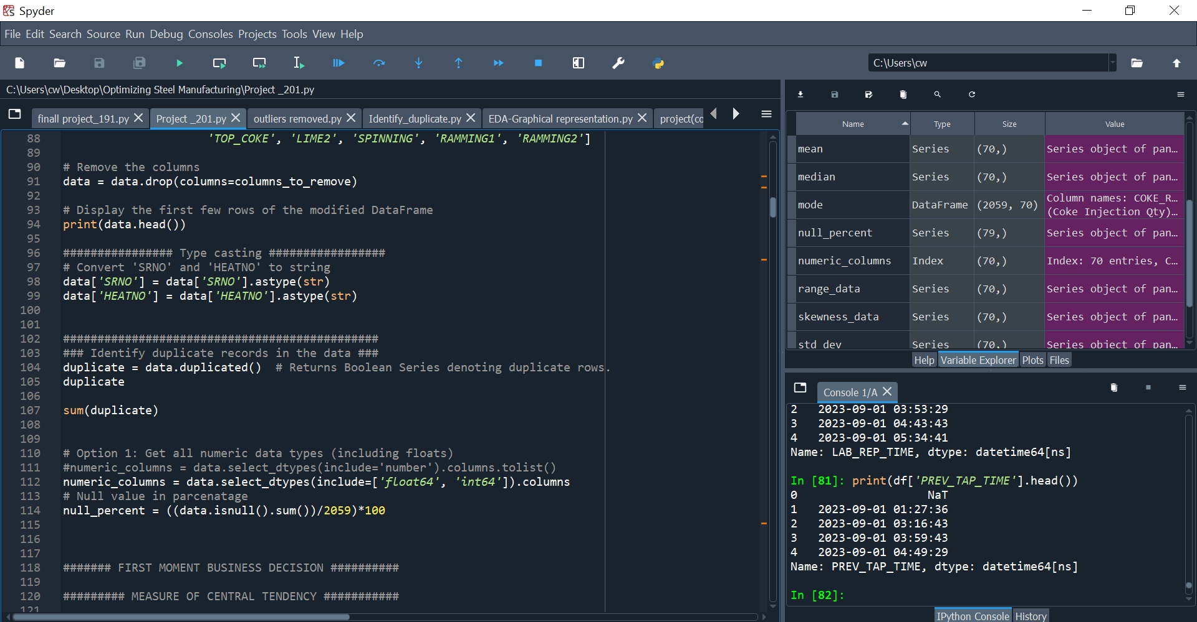
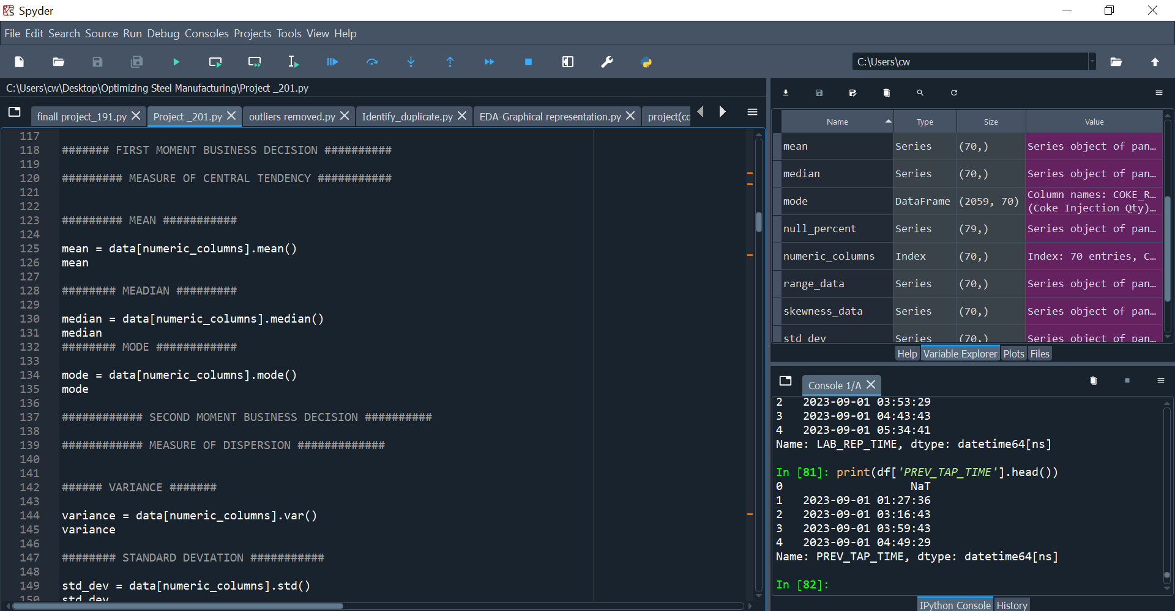
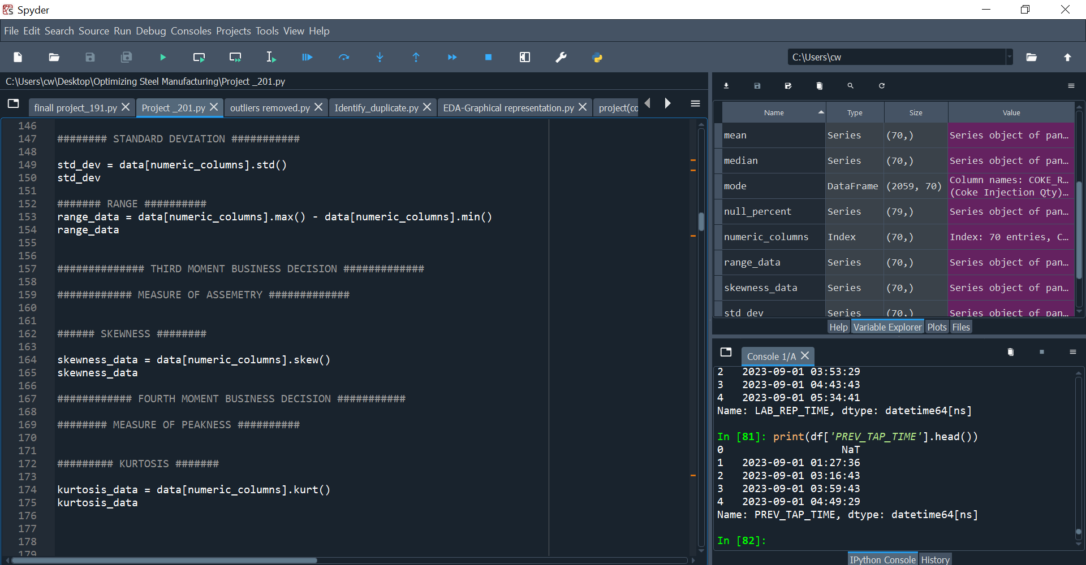
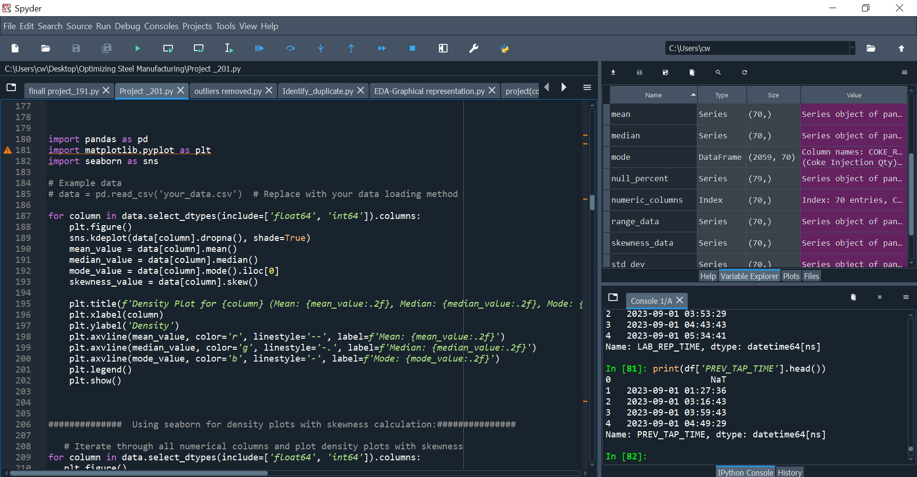
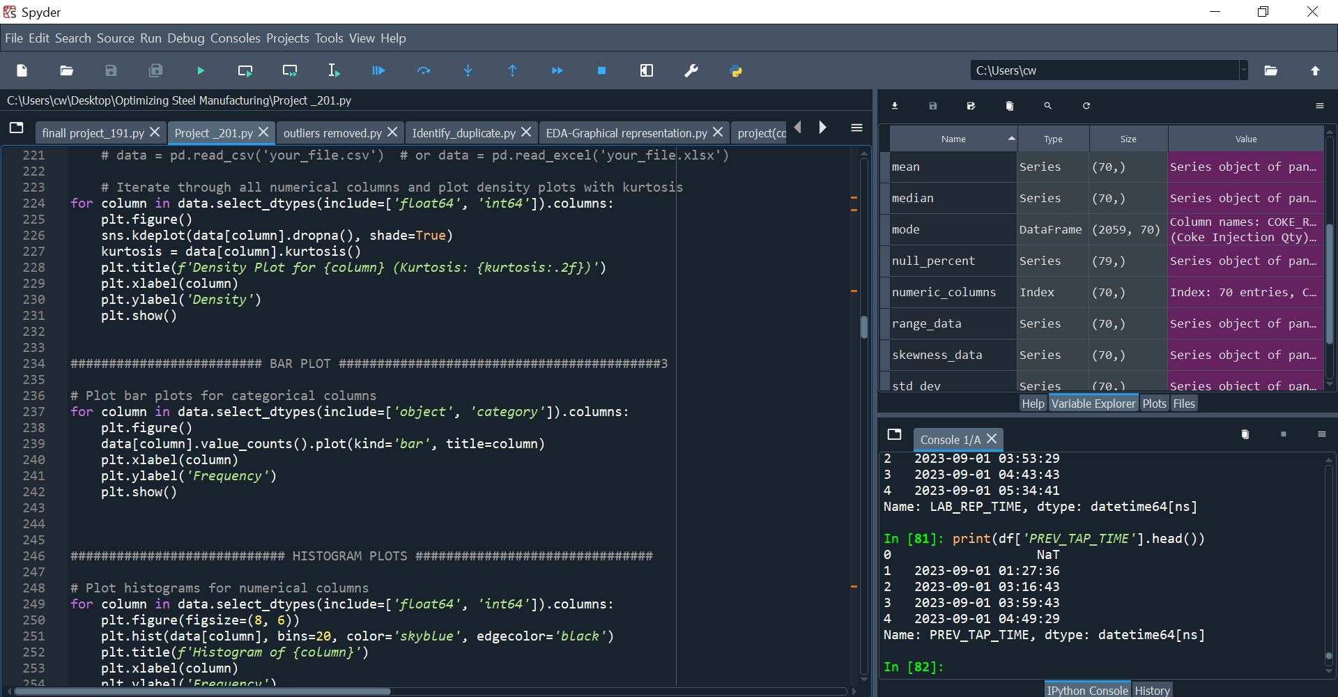
EDA - EXPLORATORY DATA ANALYSIS Python SQL)

Slide 16
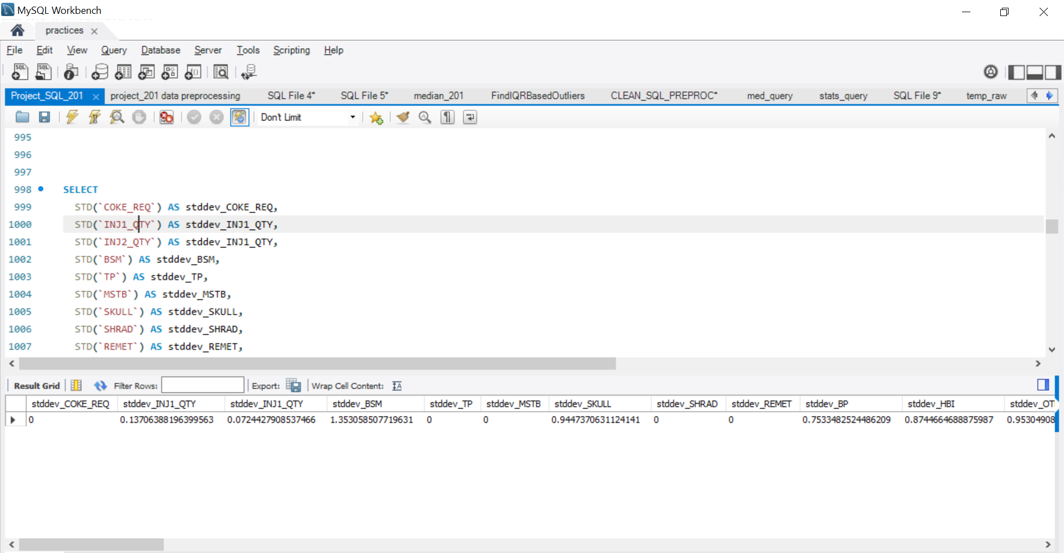
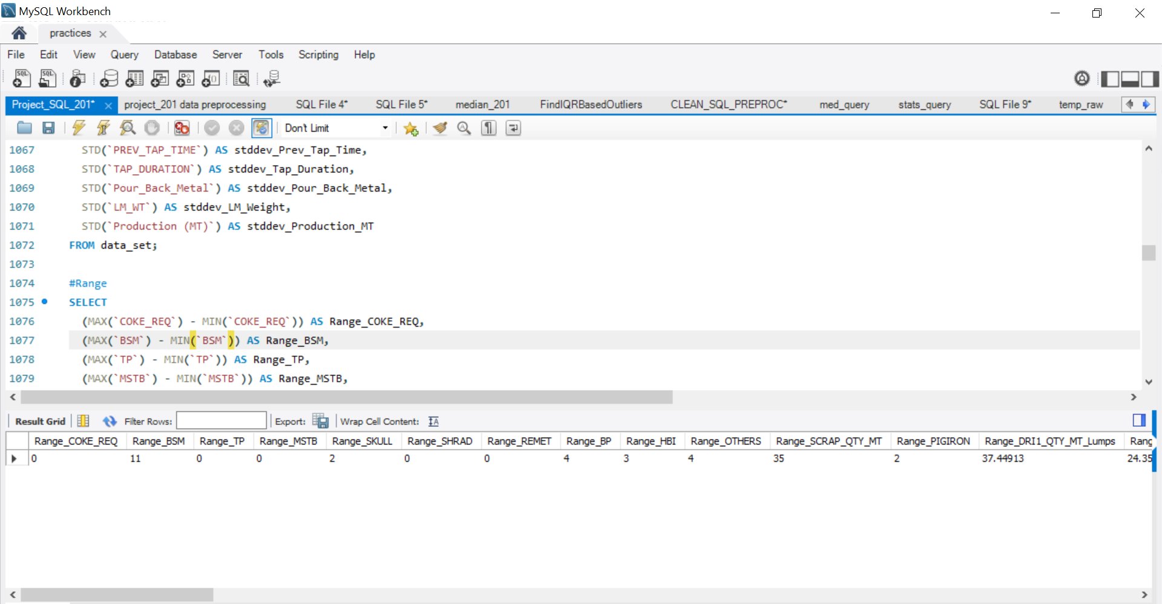
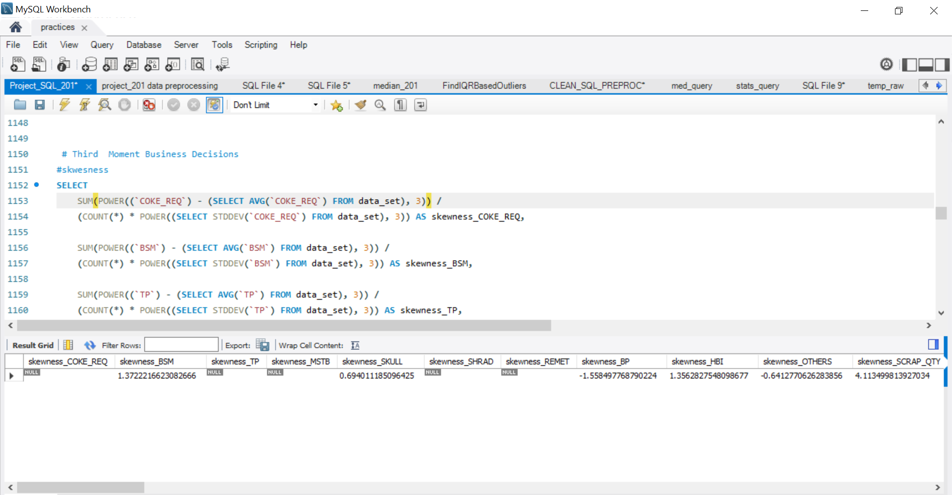
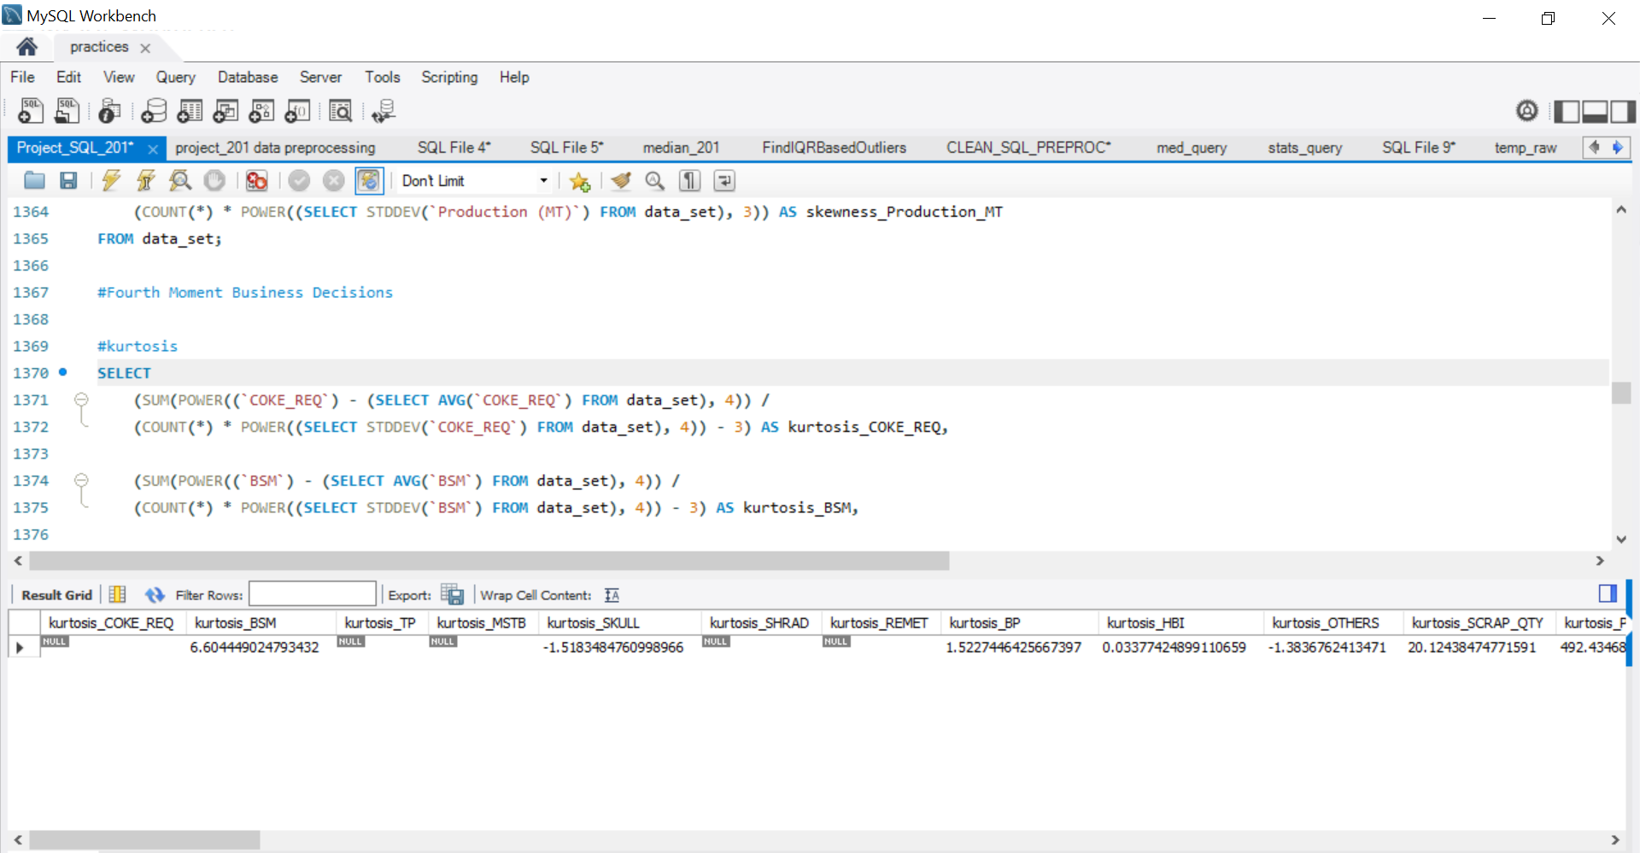
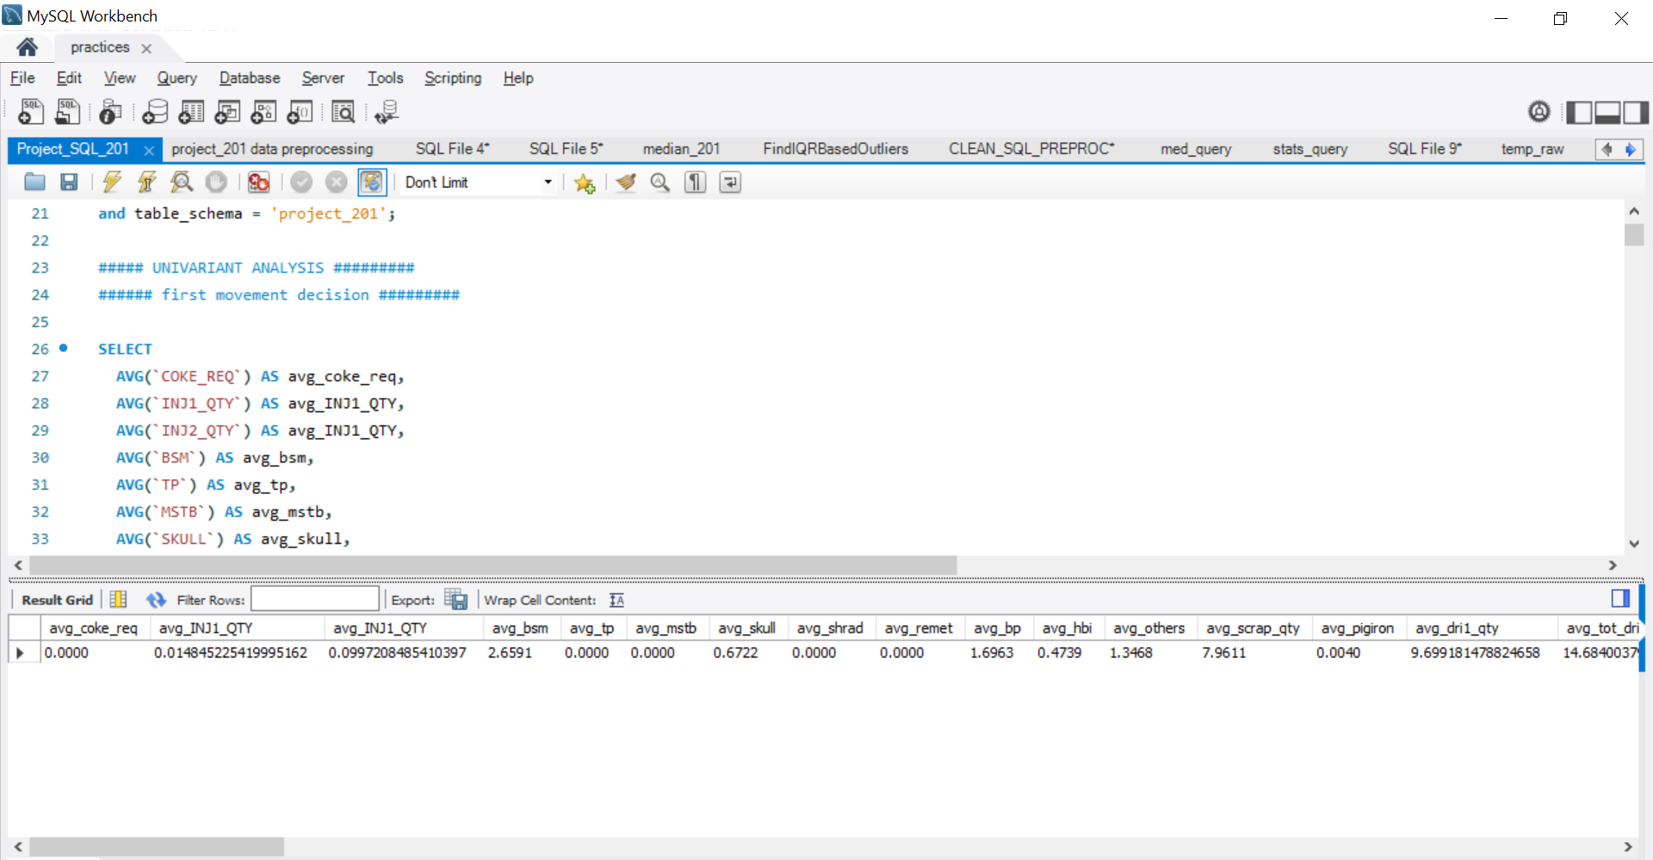
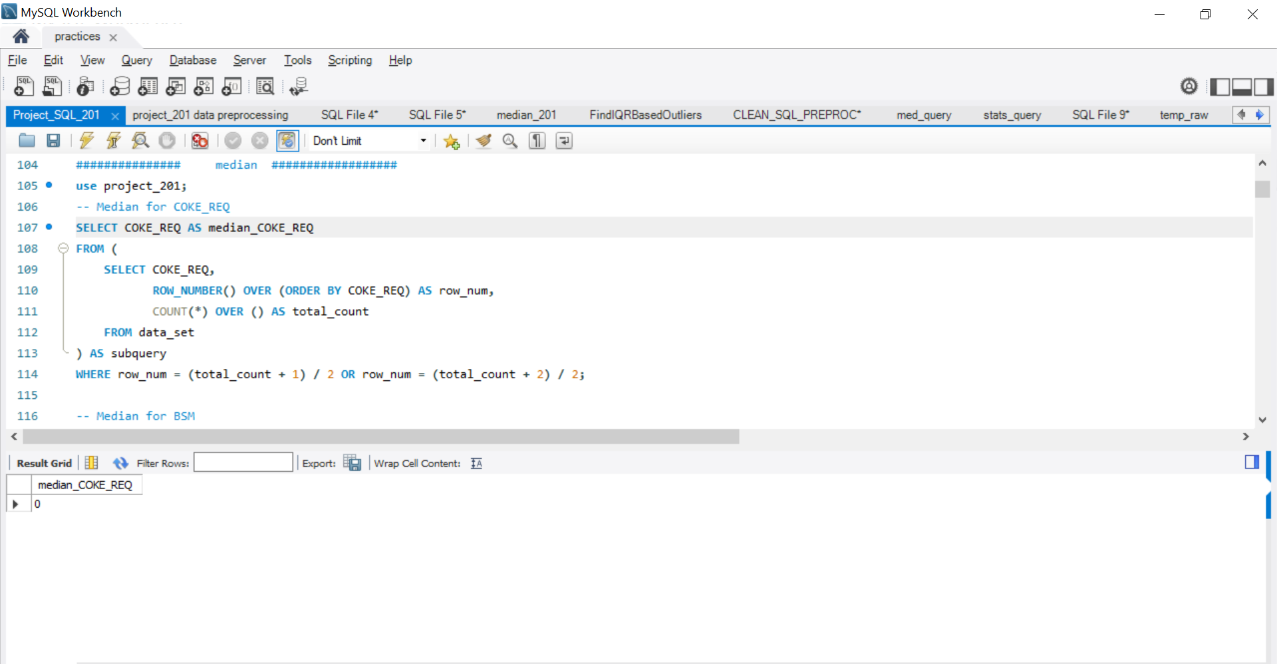
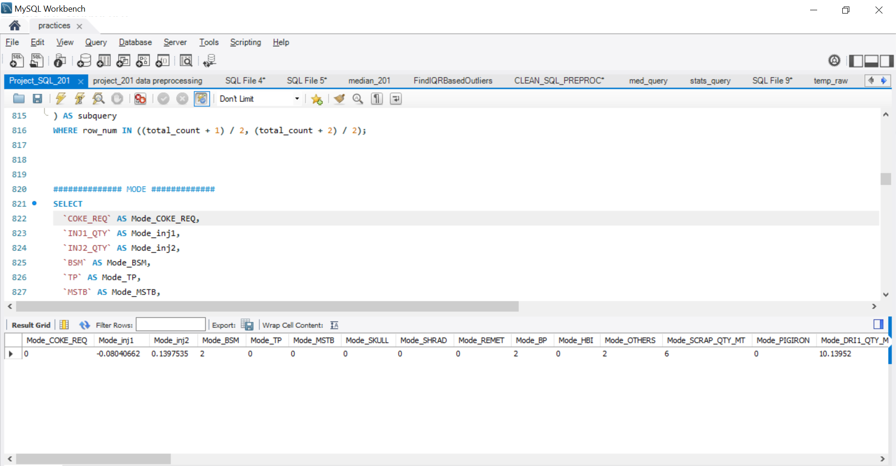
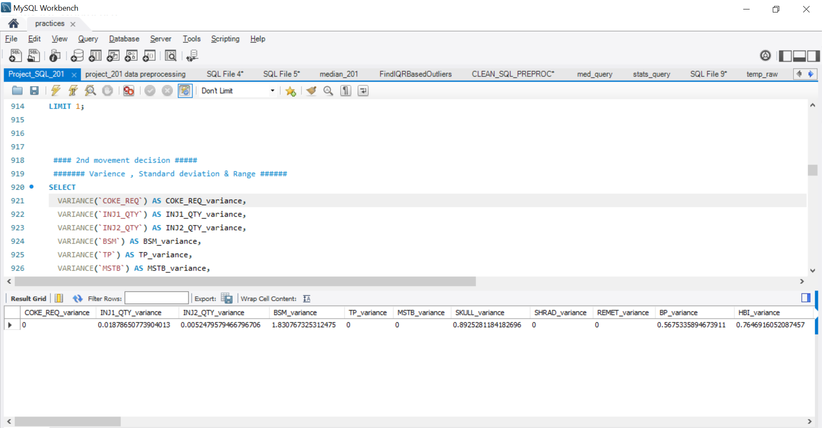
EDA - EXPLORATORY DATA ANALYSIS SQL

Slide 17
EXPLORATORY DATA ANALYSIS - (EDA) Python and SQL
ARCING_TIME | 0 | 0 | 0 | 0 | 0 | 0 | 0 | 0
DOWN_TIME | 0 | 0 | 0 | 0 | 0 | 0 | 0 | 0
E1_CUR (Electrode 1 Current) | 235.1918407 | 241.9 | 241.3 | 1855.485912 | 43.07535156 | 304 | -1.617058126 | 4.015535883
E2_CUR (Electrode 2 Current) | 226.7957747 | 234 | 235 | 1239.054686 | 35.20020861 | 246.7 | -2.39949381 | 6.80822374
E3_CUR (Electrode 3 Current) | 237.3360369 | 243.5 | 245.1 | 1543.293648 | 39.28477628 | 271.2 | -2.155161161 | 6.001477541
SPOUT (Bottom Refractory Temperature) | 292.4835357 | 303.5 | 310.3 | 2318.017434 | 48.14579352 | 309 | -2.045698297 | 5.214304365
DOLOMIT | 0 | 0 | 0 | 0 | 0 | 0 | 0 | 0
CPC | 0 | 0 | 0 | 0 | 0 | 0 | 0 | 0
TEMPERATURE | 0 | 0 | 0 | 0 | 0 | 0 | 0 | 0
POWER | 0 | 0 | 0 | 0 | 0 | 0 | 0 | 0
C | 0.190770486 | 0.1444 | 0 | 0.021282506 | 0.14588525 | 1.095 | 1.359469569 | 2.147513295
SI | 0.003066683 | 0.0016 | 0.001 | 0.000294367 | 0.017157135 | 0.637 | 27.62923603 | 935.1422733
MN | 0.022561195 | 0.021 | 0 | 0.000627216 | 0.025044276 | 0.9831 | 29.79027601 | 1085.619535
P | 0.014334653 | 0.014 | 0.012 | 2.27E-05 | 0.004761746 | 0.055 | 0.640553453 | 3.550712713
S | 0.062218786 | 0.0612 | 0 | 0.000313693 | 0.017711377 | 0.1585 | -0.069125604 | 1.891483935
CU | 0.005319621 | 0.0053 | 0.0058 | 6.97E-06 | 0.002640761 | 0.0703 | 8.614814345 | 186.5679112
CR | 0.057342982 | 0.0498 | 0 | 0.021954168 | 0.148169388 | 6.6578 | 43.01461547 | 1916.081199
NI | 0.020586838 | 0.0177 | 0.0174 | 0.00014148 | 0.011894521 | 0.1363 | 4.16002159 | 24.08999035
N | 0.003330758 | 0.0033 | 0.0033 | 2.04E-06 | 0.001426987 | 0.036 | 17.78383815 | 374.8793921
TIME_UTLN_PRCNT | 0 | 0 | 0 | 0 | 0 | 0 | 0 | 0
TOP_COKE | 0 | 0 | 0 | 0 | 0 | 0 | 0 | 0
OPEN_C | 0.228870369 | 0.1879 | 0 | 0.027690734 | 0.16640533 | 1.095 | 1.183783927 | 1.540456478
TAP_C | 0.190770486 | 0.1444 | 0 | 0.021282506 | 0.14588525 | 1.095 | 1.359469569 | 2.147513295
IT_KG | 137.2494762 | 134.3645 | 0 | 2068.693937 | 45.48289719 | 573.8116 | 2.070019602 | 12.91341697
BUCKET_NO | 1.025740651 | 1 | 1 | 0.025090255 | 0.158399038 | 1 | 5.993981676 | 33.96080308
STATIC_WT | 7.343814959 | 7.3 | 0 | 10.77912855 | 3.283158319 | 50.357 | 4.069223612 | 47.98826398
LIME | 1.024643992 | 1.023335 | 0 | 0.318912669 | 0.564723534 | 4.5017409 | 0.806589668 | 1.84478583
LIME2 | 0 | 0 | 0 | 0 | 0 | 0 | 0 | 0
O2SIDE1 | 840.7069664 | 829.4841 | 281.6221 | 12524.93197 | 111.9148425 | 1403.8589 | 1.395618819 | 7.215623712
O2SIDE2 | 752.1666392 | 749.1741 | 0 | 13133.61685 | 114.6019932 | 1515.247 | 0.05466652 | 7.409774735
O2SIDE3 | 539.9631856 | 555.0499 | 0 | 19476.40561 | 139.5578934 | 1139.13 | -0.262584994 | 0.319512809
SPINNING | 0 | 0 | 0 | 0 | 0 | 0 | 0 | 0
RAMMING1 | 0 | 0 | 0 | 0 | 0 | 0 | 0 | 0
RAMMING2 | 0 | 0 | 0 | 0 | 0 | 0 | 0 | 0
TAP_DURATION | 385.4497329 | 337 | 297 | 73994.60619 | 272.019496 | 3779 | 6.057841624 | 54.90295706
Pour_Back_Metal | 0.112821758 | 0 | 0 | 0.84362561 | 0.918490942 | 30 | 20.49113291 | 579.4594995
LM_WT | 4.570623323 | 4.570687 | 4.550908 | 0.012489923 | 0.111758322 | 0.680286 | 0.072320511 | 0.146020835
Production (MT) | 55.64790768 | 56.175 | 56.7 | 17.45898359 | 4.178394858 | 66.959 | -4.496685253 | 46.83114499
Column Name | Mean | Median | Mode | Varience | Std_varience | Range | Skewness | Kurtosis
COKE_REQ | 0 | 0 | 0 | 0 | 0 | 0 | 0 | 0
INJ1_QTY (Coke Injection Qty) | 0.014845225 | 0.005374847 | 0 | 0.018795636 | 0.137097178 | 6.090699 | -14.41662928 | 462.4293121
INJ2_QTY (Coke Injection Qty) | 0.099720849 | 0.08349536 | 0.04053174 | 0.005250508 | 0.072460389 | 0.7939366 | 1.719350663 | 7.163661442
BSM | 3.465274405 | 3 | 2 | 9.834920855 | 3.136067738 | 26 | 2.529738218 | 6.474575043
TP | 0 | 0 | 0 | 0 | 0 | 0 | 0 | 0
MSTB | 0 | 0 | 0 | 0 | 0 | 0 | 0 | 0
SKULL | 0.672170957 | 0 | 0 | 0.892961806 | 0.944966563 | 2 | 0.694517247 | -1.51912233
SHRAD | 0 | 0 | 0 | 0 | 0 | 0 | 0 | 0
REMET | 0 | 0 | 0 | 0 | 0 | 0 | 0 | 0
BP | 1.788246722 | 2 | 2 | 1.05620776 | 1.02771969 | 14 | 2.002186729 | 17.93852635
HBI | 0.495871782 | 0 | 0 | 0.86040569 | 0.927580557 | 5 | 1.631926877 | 2.004334505
OTHERS | 1.420592521 | 2 | 2 | 1.286572827 | 1.134271937 | 7 | 0.905859292 | 4.772959974
SCRAP_QTY (MT) | 7.961146187 | 7 | 6 | 20.35611841 | 4.511775528 | 35 | 4.116499327 | 20.17625935
PIGIRON | 0.081107334 | 0 | 0 | 0.547840173 | 0.740162261 | 12 | 13.08349437 | 197.1129666
DRI1_QTY (MT) (Lumps) | 9.699181479 | 9.528663 | 0 | 16.05014869 | 4.006263682 | 37.44913 | 0.540047936 | 1.706236518
DRI2_QTY (MT) (Fines) | 4.964609949 | 5.022748 | 0 | 3.055302249 | 1.74794229 | 10.02142 | -1.525006255 | 2.269572842
TOT_DRI_QTY | 14.66379142 | 14.8691 | 0 | 17.00481557 | 4.123689557 | 37.44913 | -0.19544134 | 1.082951379
HOT_METAL (HOT Metal from MBF) | 43.46996406 | 43.942 | 0 | 17.71652119 | 4.209099808 | 55.36 | -3.960188424 | 31.88731166
Total Charge | 66.176009 | 66.04749 | 66.51296 | 39.06069723 | 6.249855777 | 61.623777 | 0.509982018 | 5.59274389
Hot_Heel (Left Over Liquid metal in EAF) | 10.08572122 | 10 | 10 | 2.644616231 | 1.626227607 | 16 | 0.398727384 | 5.334155975
DOLO | 1.884902954 | 1.923484 | 1.2 | 0.254272601 | 0.5042545 | 3.436178 | -0.419963527 | 0.78126435
DOLO1_EMPTY | 1.647235037 | 1.553691 | 0 | 0.26617785 | 0.515924268 | 5.14685 | 0.777348088 | 2.366126435
TOT_LIME_QTY | 2.909546938 | 2.921386 | 1.2 | 0.541020708 | 0.735541099 | 6.008399 | -0.057712139 | 0.545442083
TAP_TEMP (Tappnig Temperature) | 1643.396309 | 1634 | 1632 | 112072.1937 | 334.7718532 | 6554 | 11.51829817 | 181.2052661
O2REQ | 0 | 0 | 0 | 0 | 0 | 0 | 0 | 0
O2ACT | 562.1885784 | 563.069 | 0 | 7723.397996 | 87.8828652 | 1082.108 | -0.028890495 | 3.555429082
ENERGY (Energy Consumption) | 9988.949562 | 9859.194 | 11169.56 | 11577197.61 | 3402.52812 | 49078.66 | 2.494136499 | 24.13752125
KWH_PER_TON (Energy Consumption Per Ton) | 151.6788367 | 149.7677 | 0 | 2444.486539 | 49.44174895 | 725.0042 | 2.459089254 | 21.7823597
KWH_PER_MIN | 3.576493443 | -1 | -1 | 1944.472644 | 44.09617494 | 448 | 9.555301823 | 89.55795894
MELT_TIME (Melting Time) | 42.38967136 | 39.75000001 | 40.96666667 | 190.1006386 | 13.78769881 | 214.4833333 | 6.865054275 | 70.36842784

Slide 18
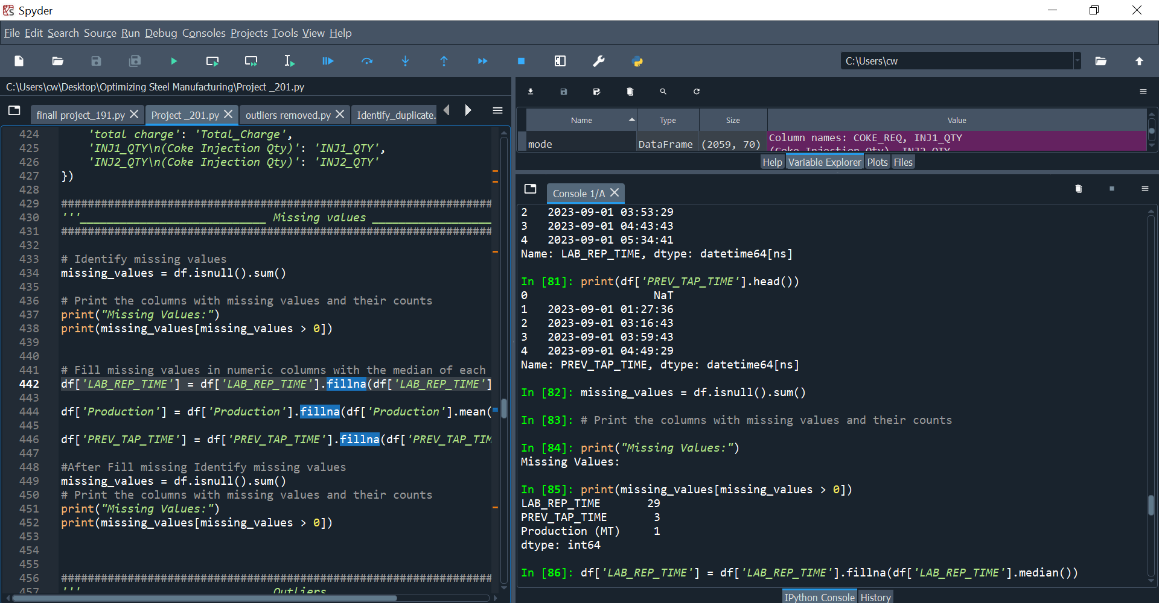
MISSING VALUES OBSERVATION
Observations has 3 columns missing values are there 1. LAB_REP_TIME - 29 row missing , PREV_TAP_TIME - 3 row missing . ,Production (MT) -1 row missing

Slide 19
DATA PREPROCESSING IN PYTHON
In the data preprocessing phase, several steps were undertaken:
Identified missing values across columns.
Replaced missing values with appropriate techniques.
Detected outliers within the dataset.

Slide 20
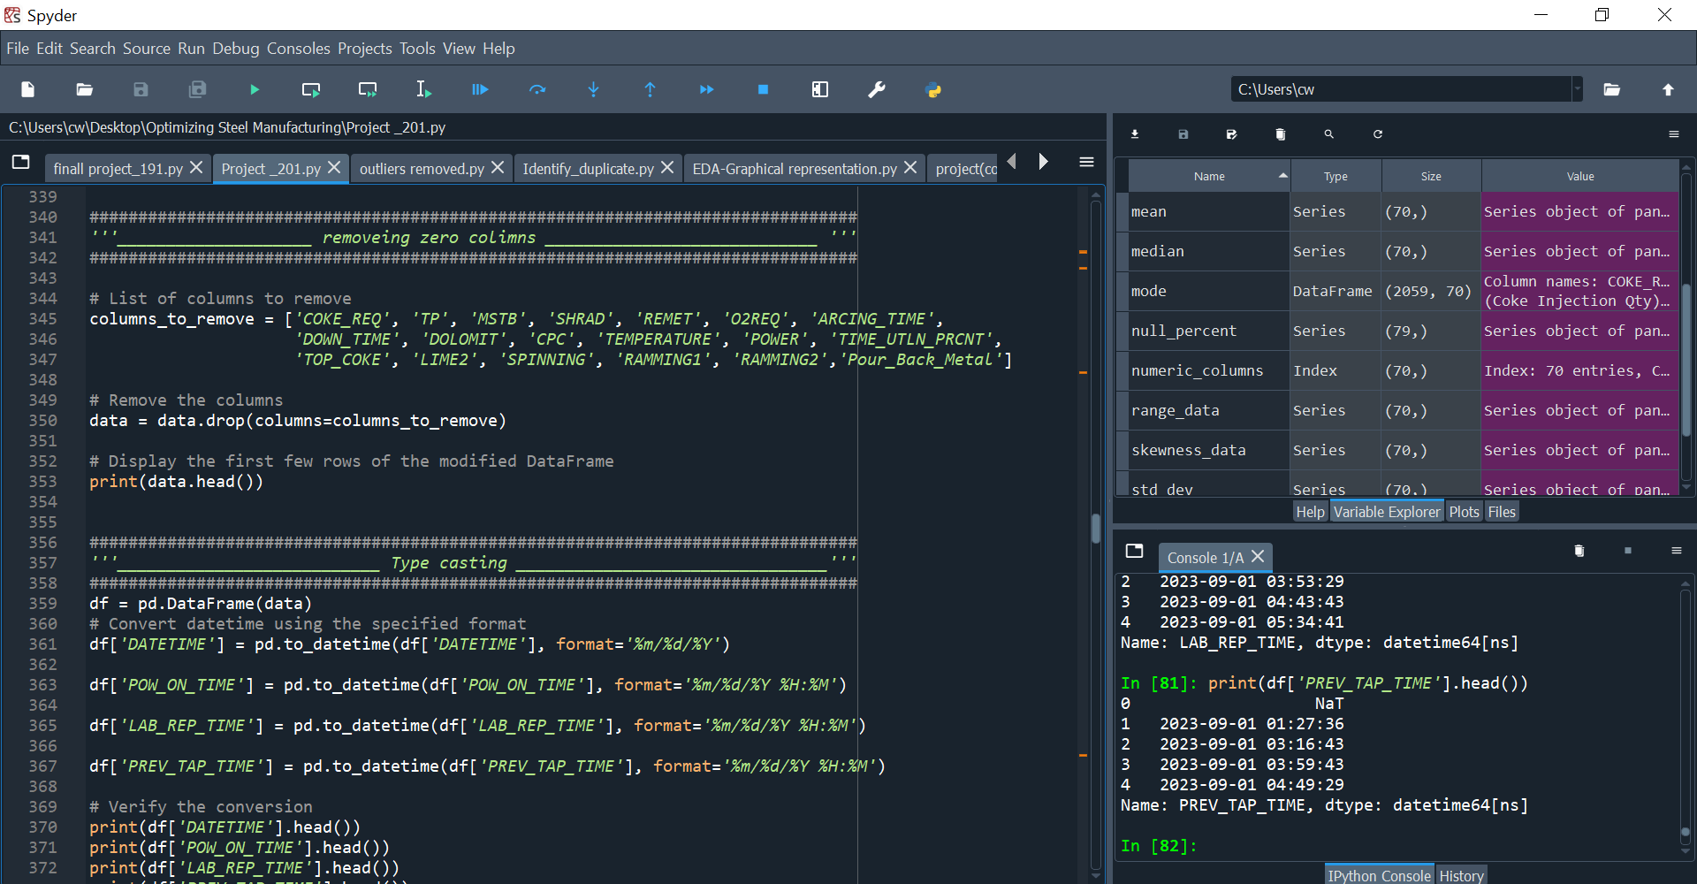
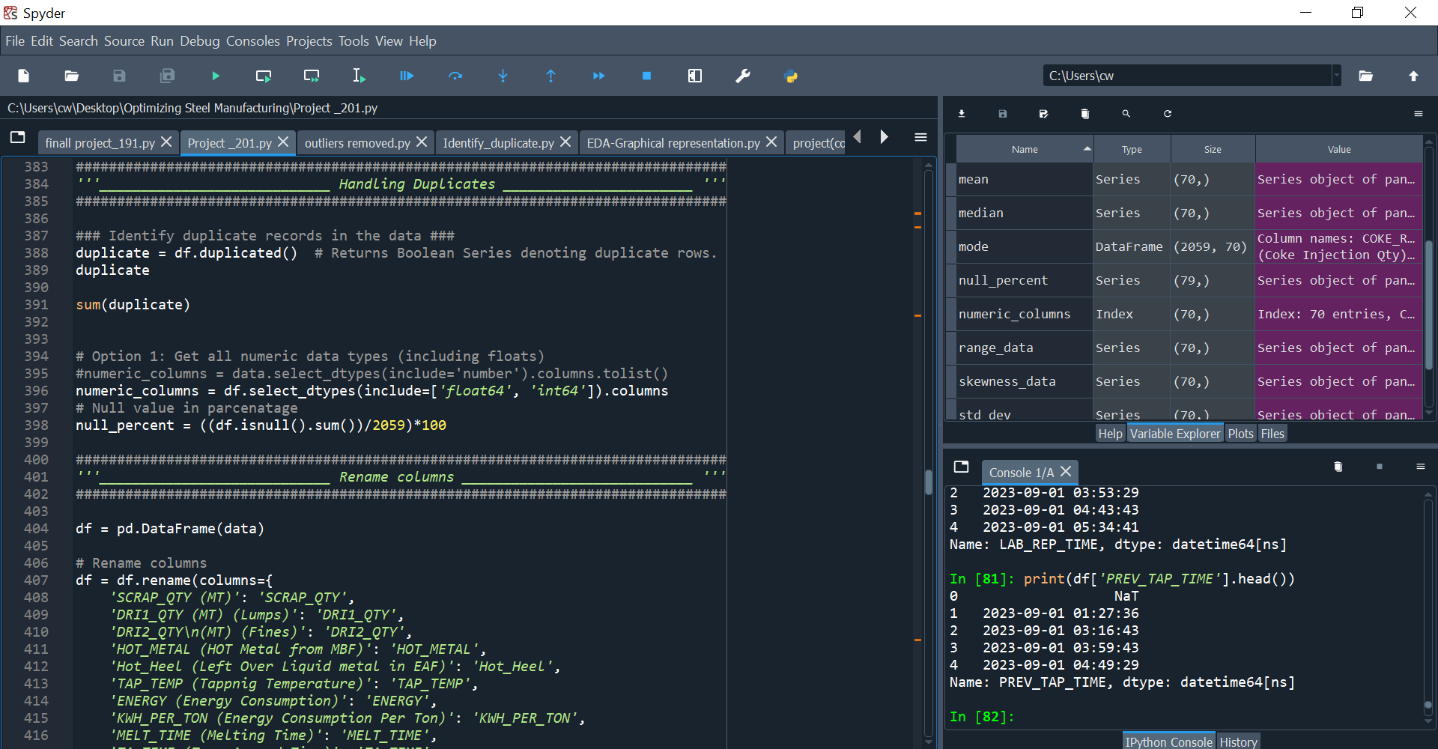
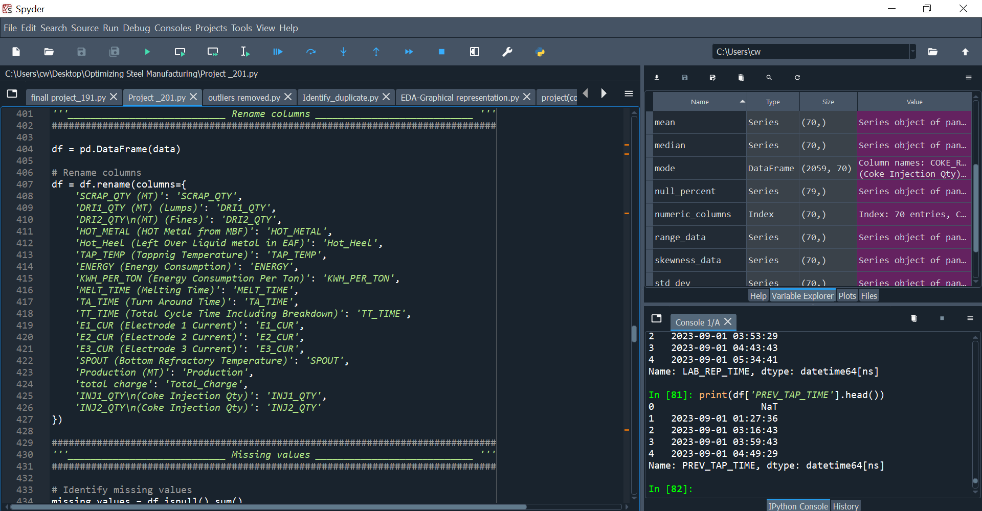
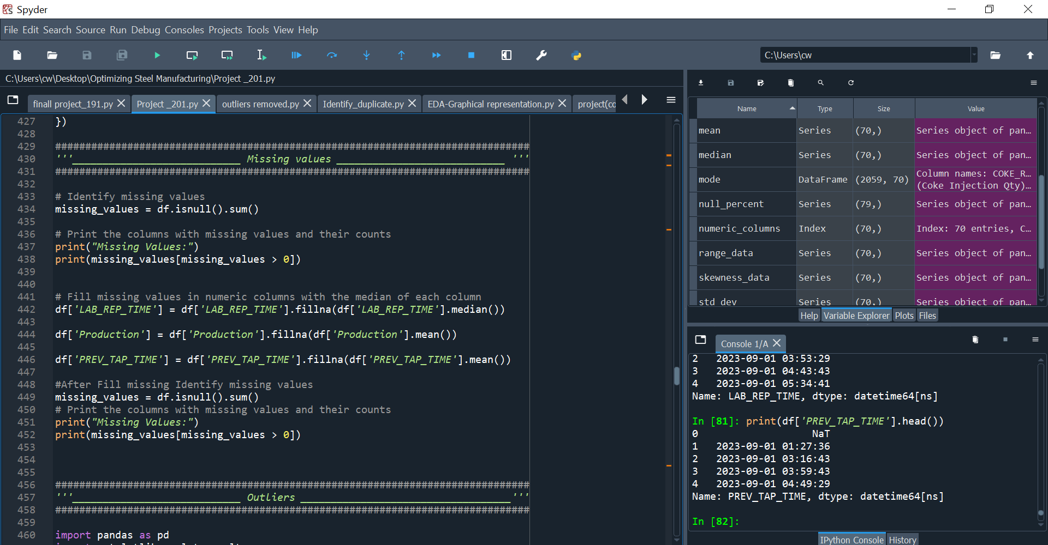
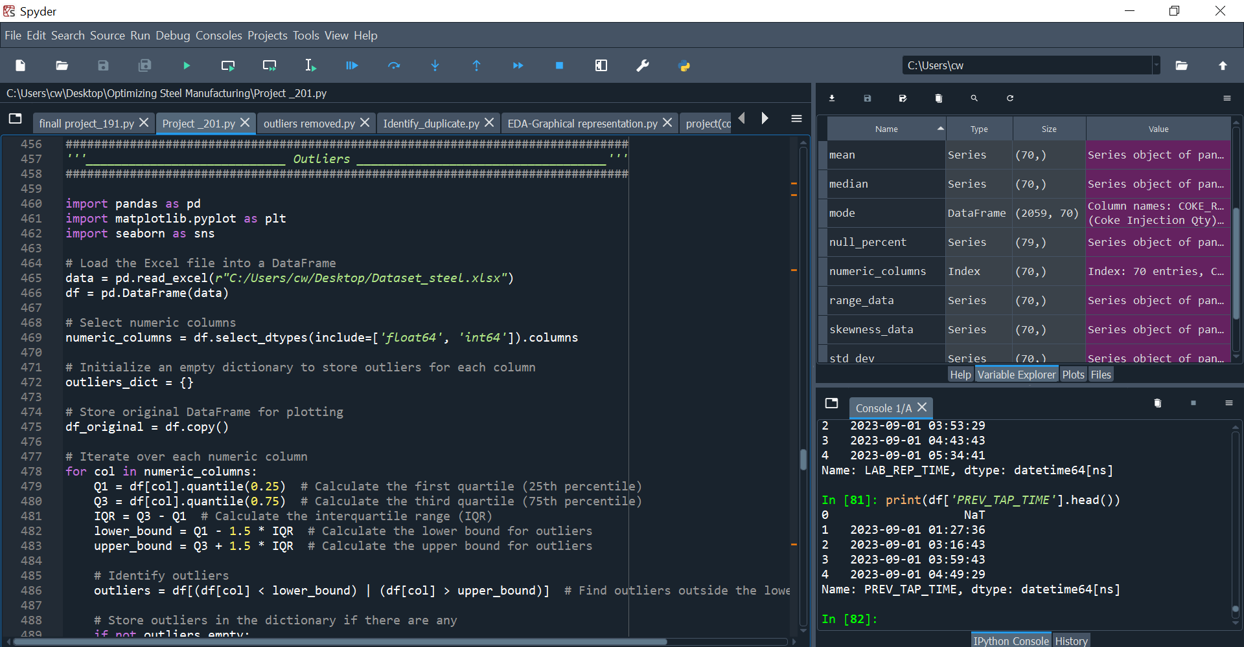
DATA PREPROCESSING IN PYTHON

Slide 21
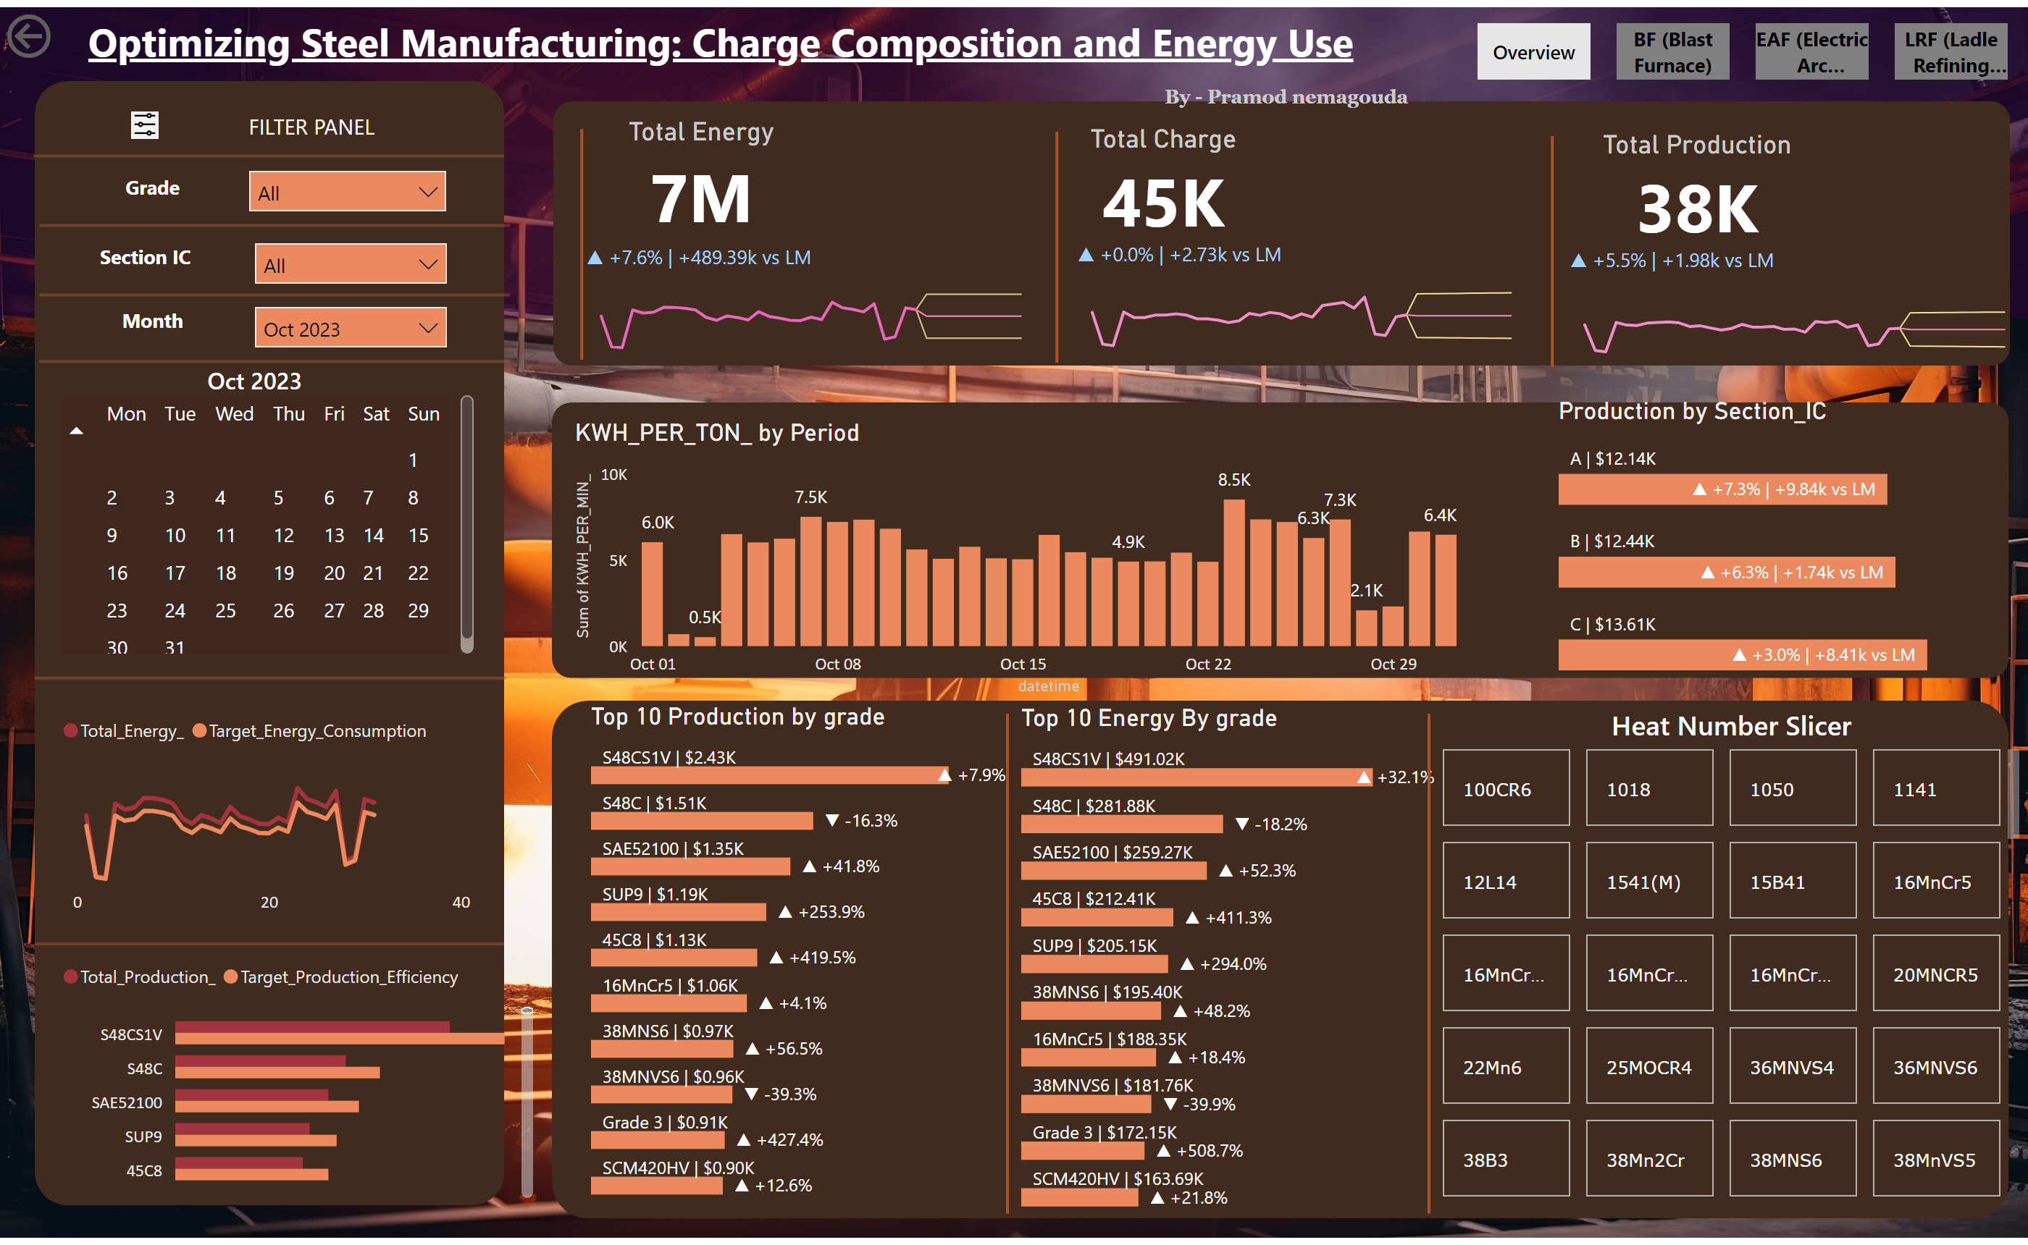
DATA VISUALIZATION IN POWER BI

Slide 22
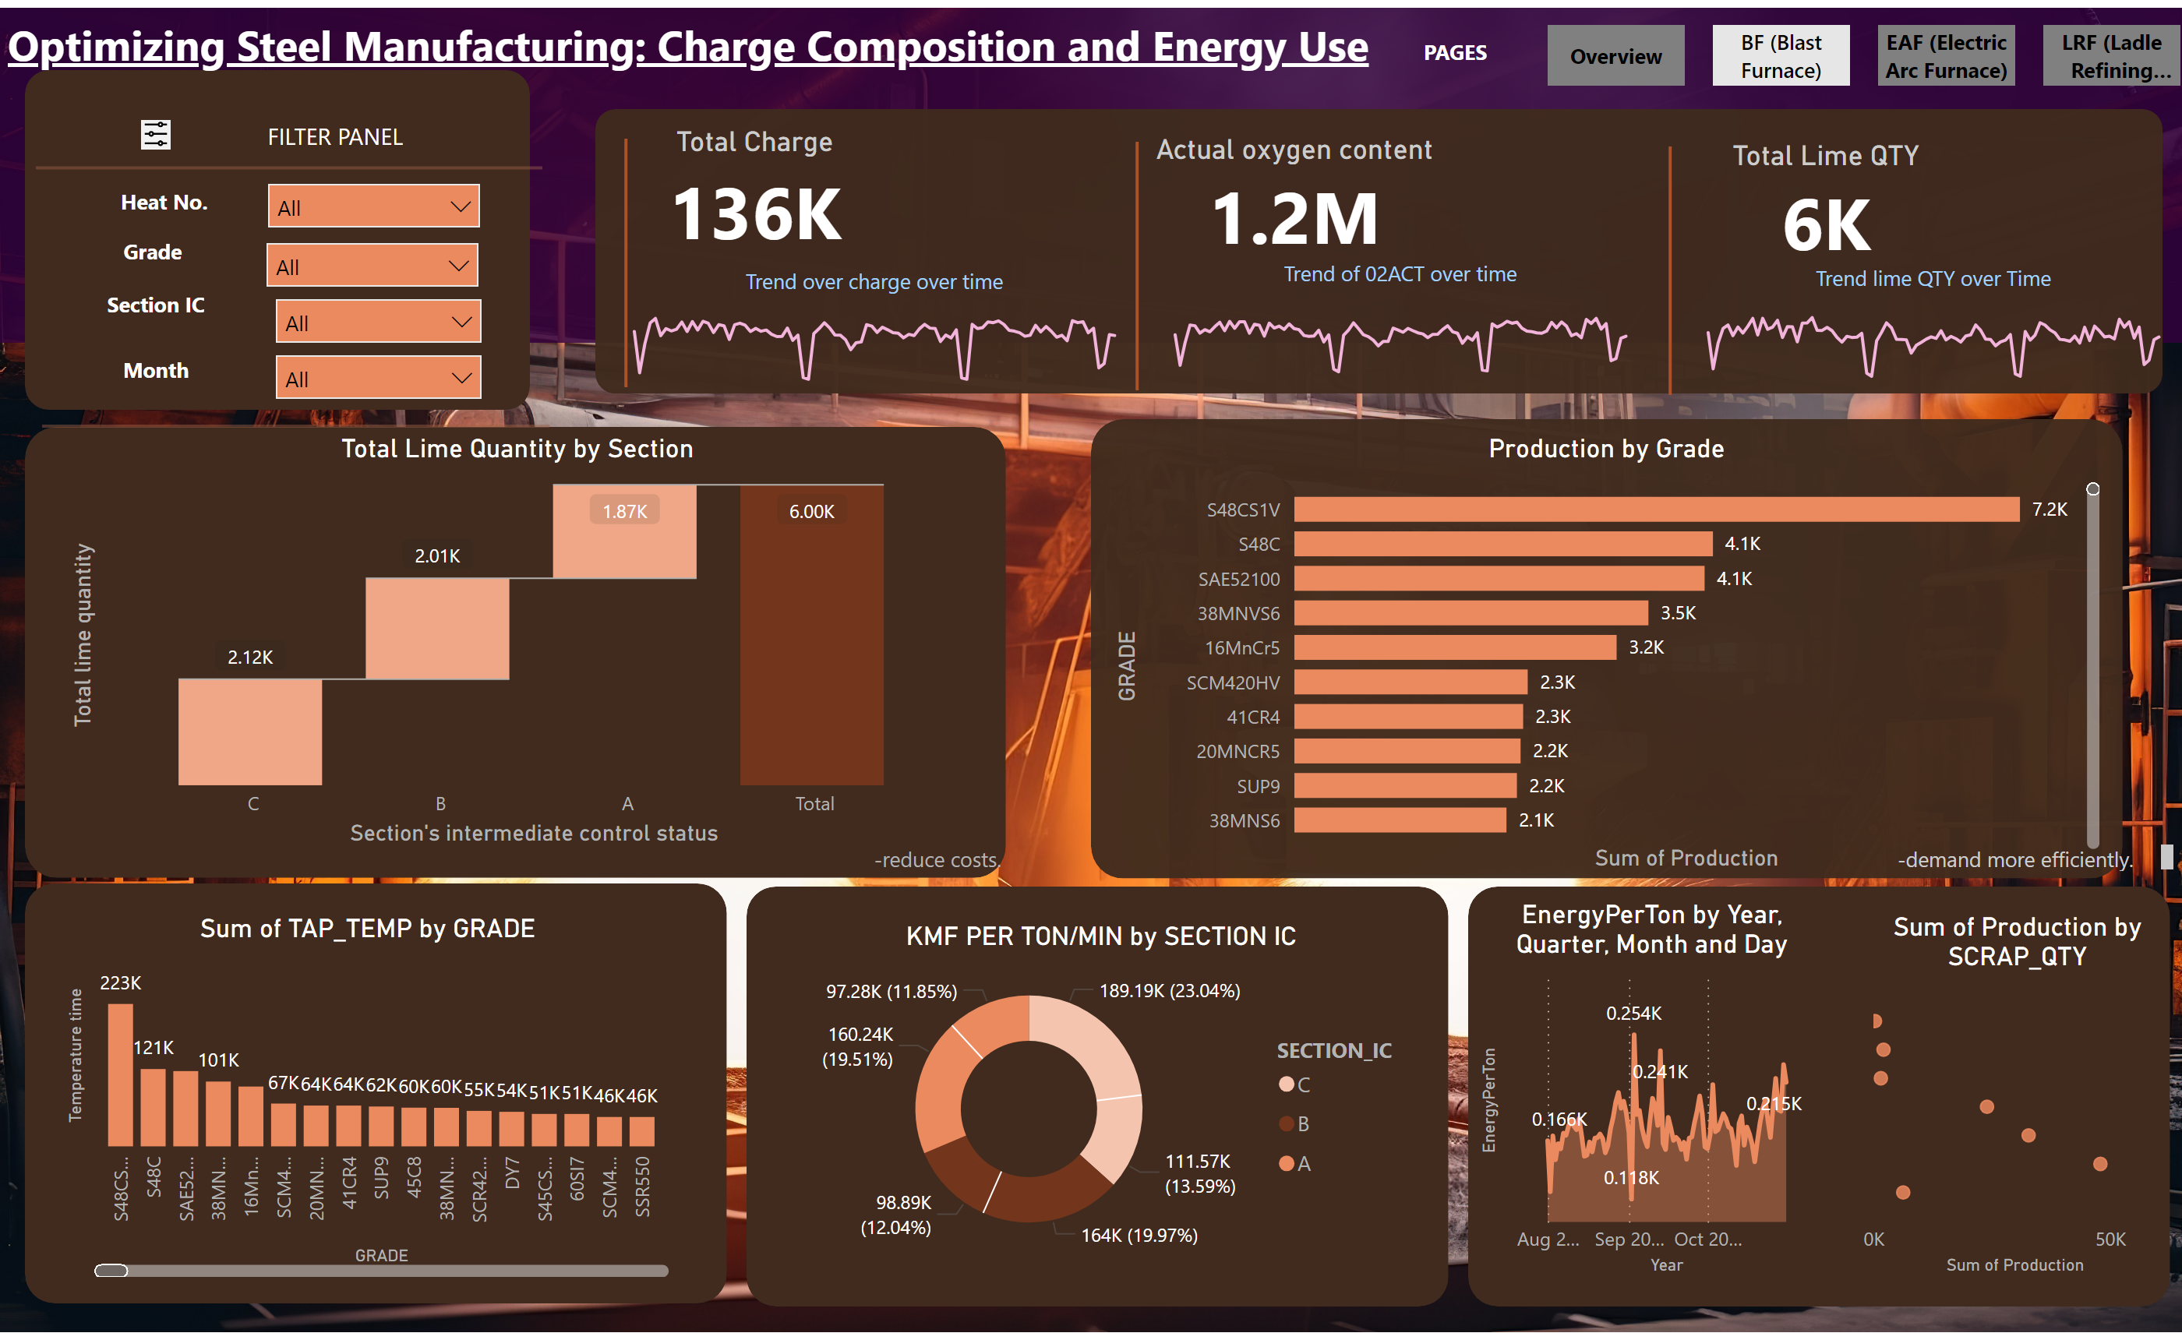
DATA VISUALIZATION IN POWER BI

Slide 23
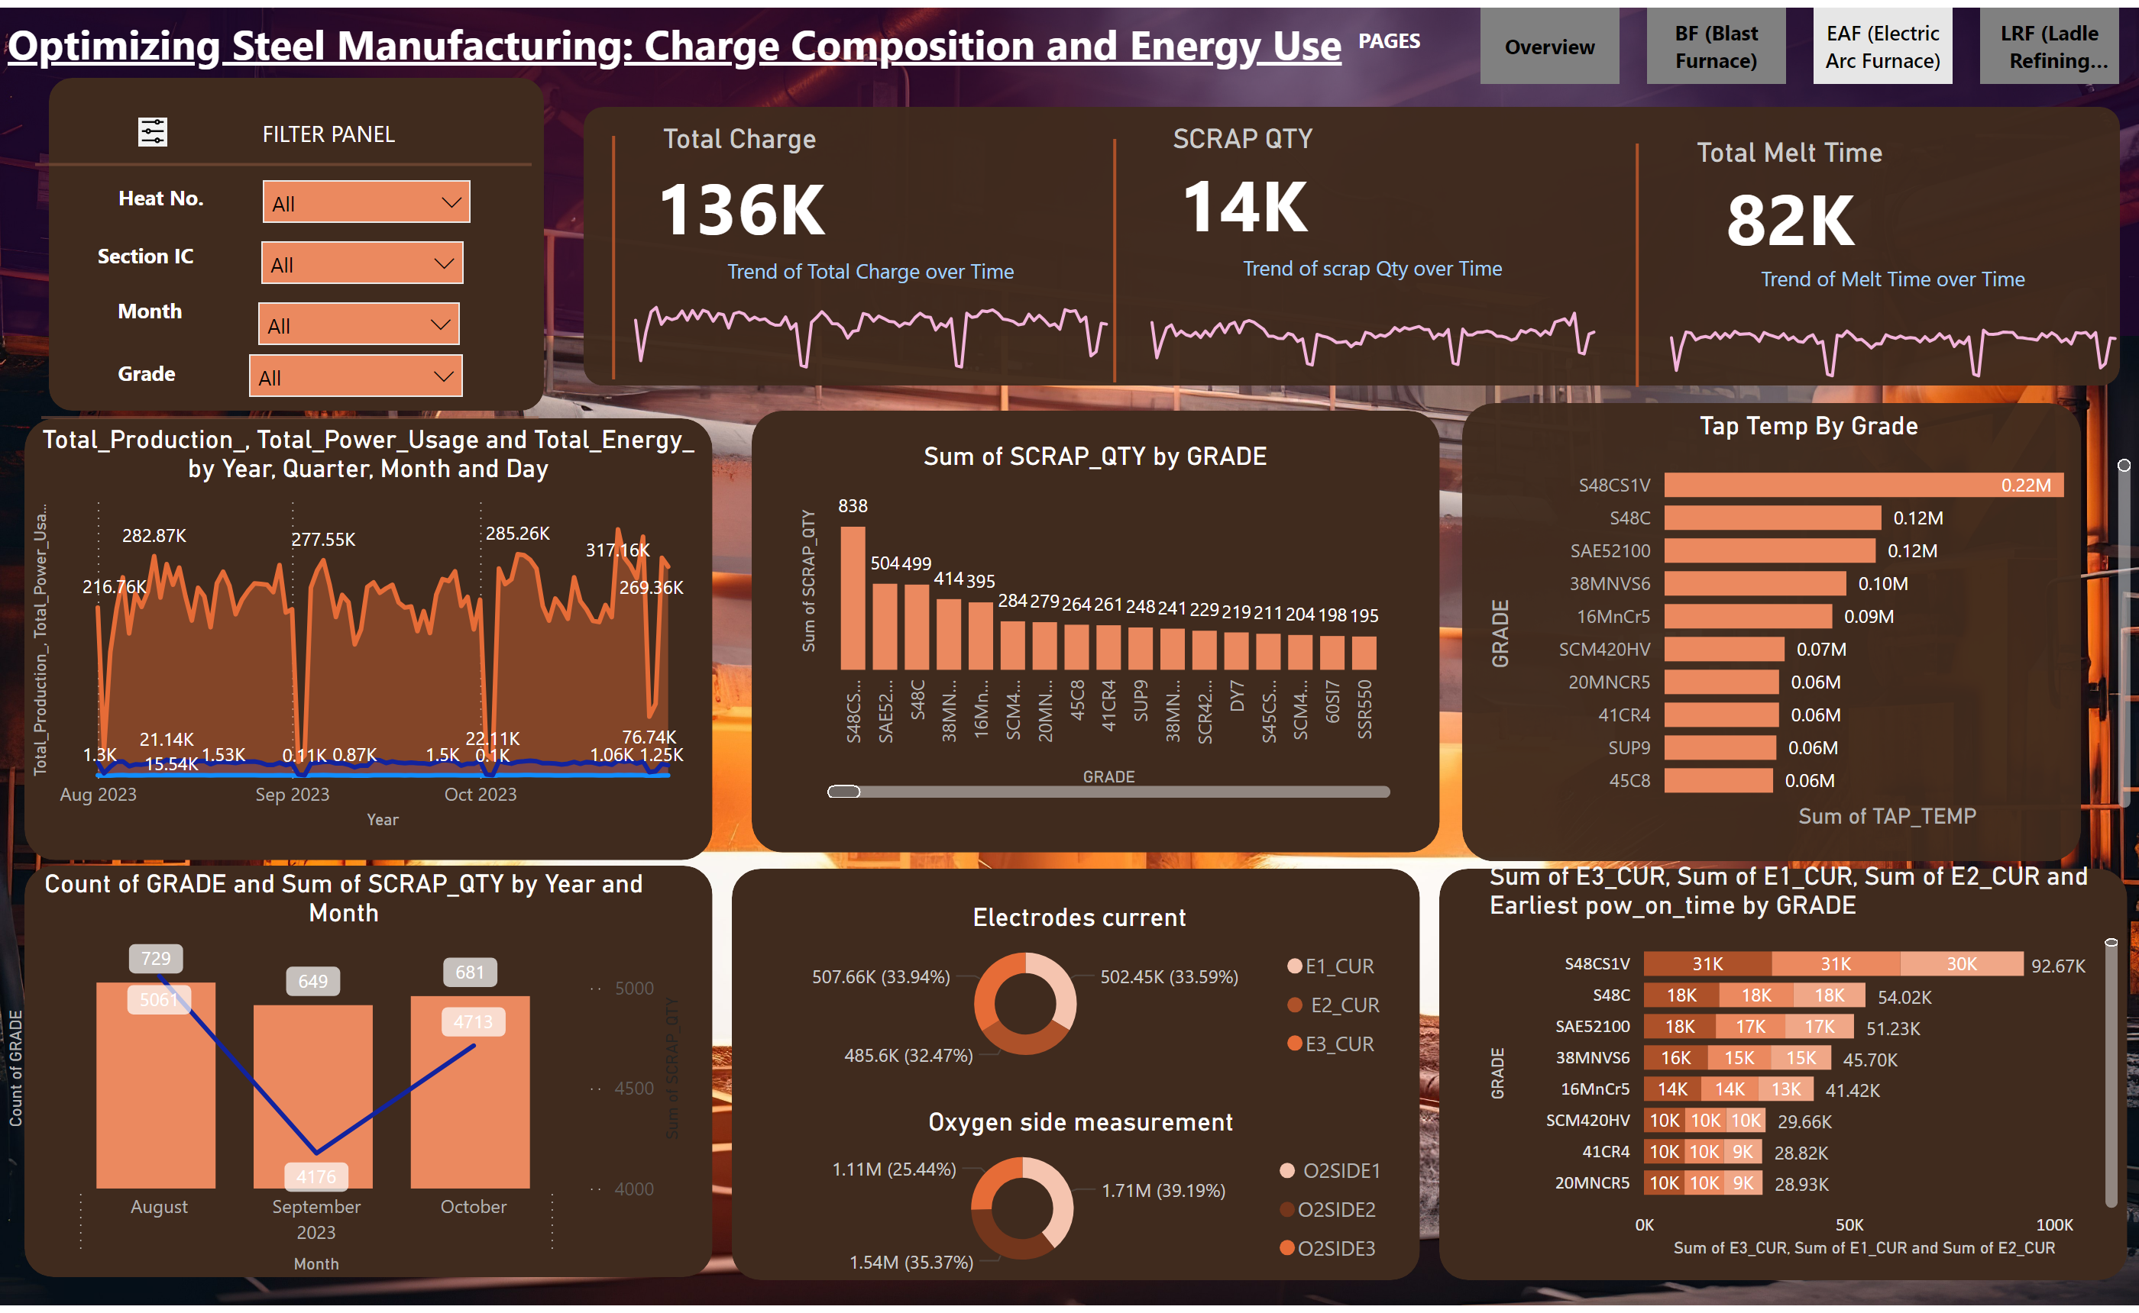
DATA VISUALIZATION IN POWER BI

Slide 24
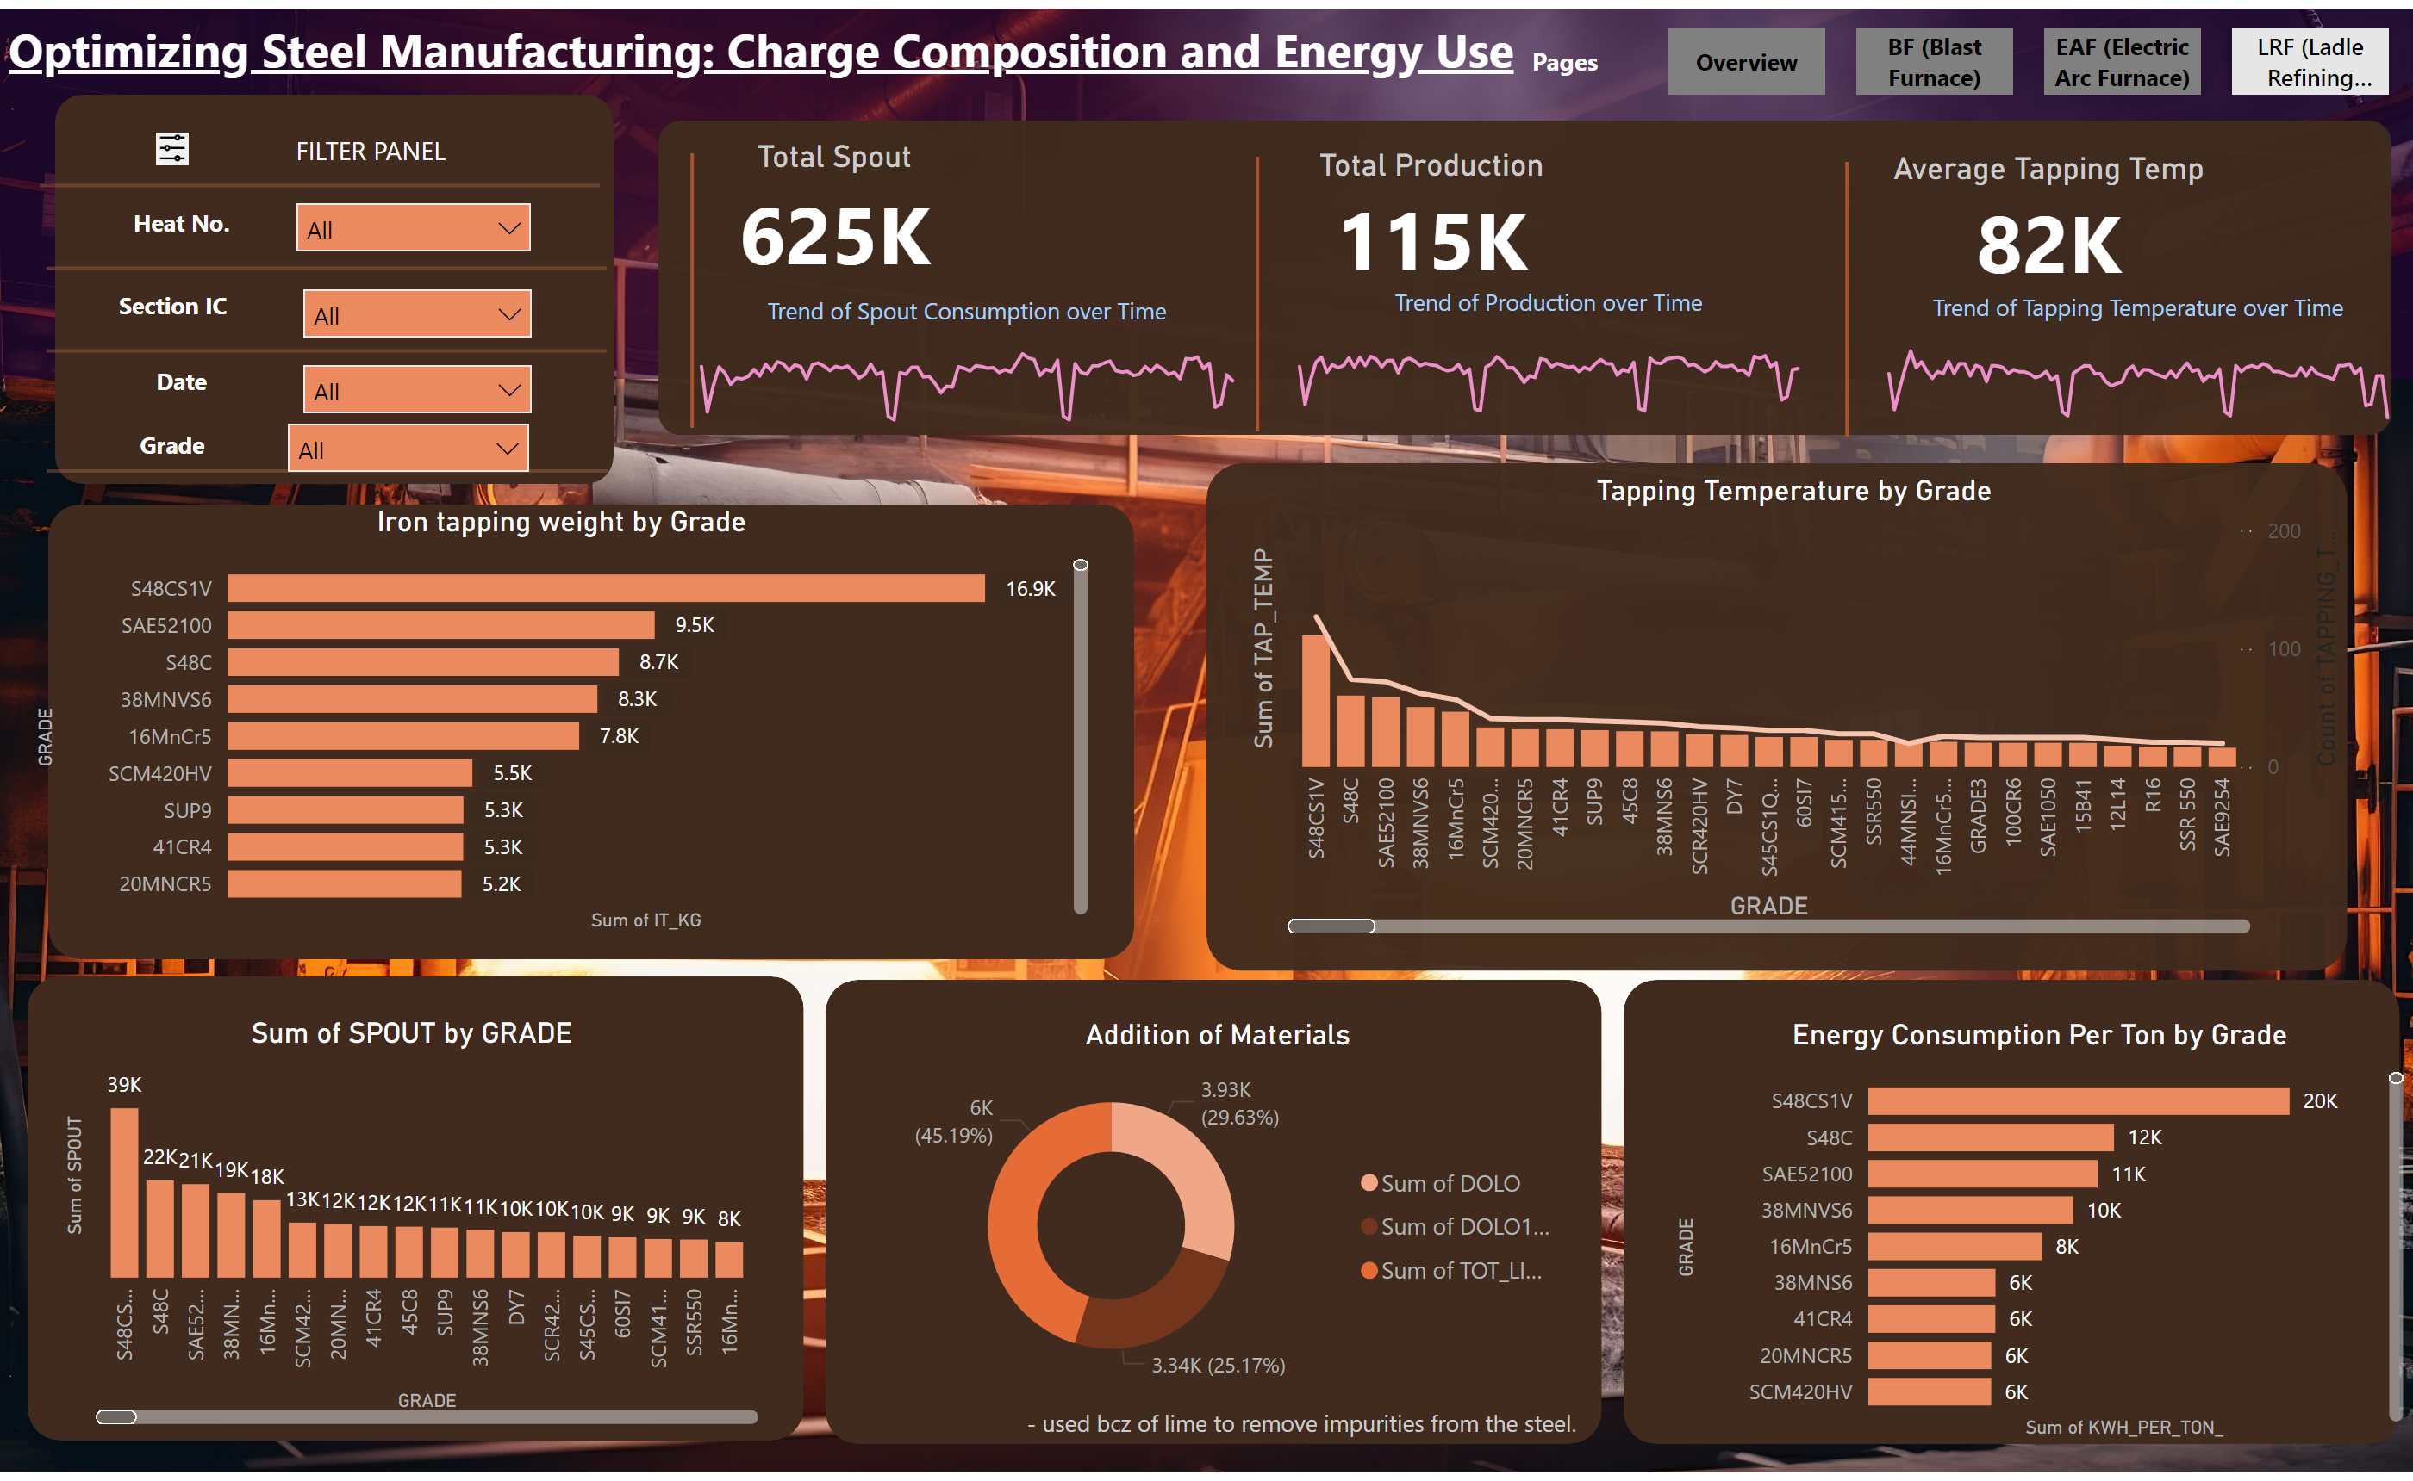
DATA VISUALIZATION IN POWER BI

Slide 25
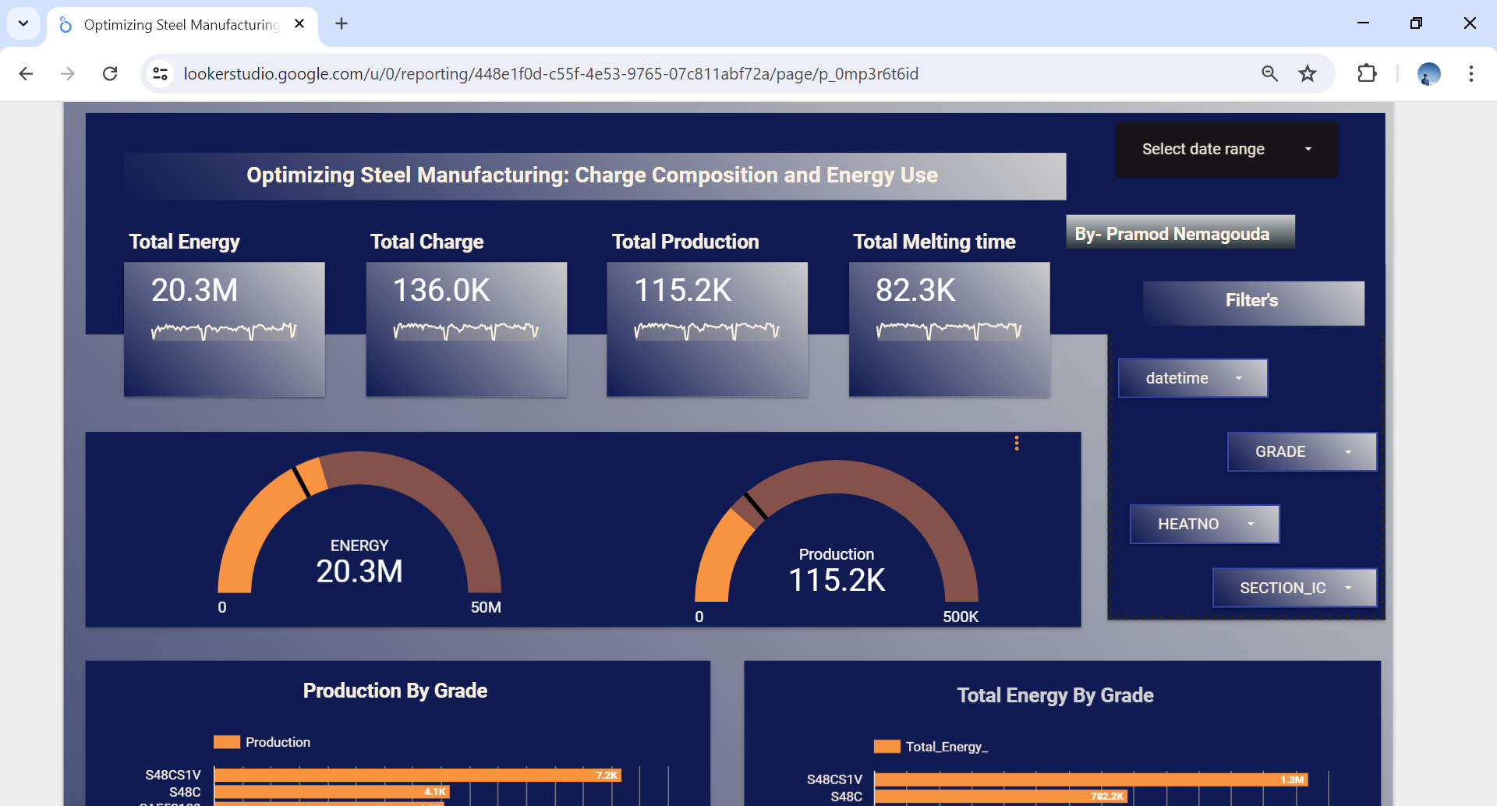
DATA VISUALIZATION IN GOOGLE LOOKER STUDIO

Slide 26
DATA VISUALIZATION
• In data visualization, various techniques were employed to illustrate insights:
• Stacked Bar Chart: Highlighting material movement patterns.
• Line Chart : Tracking amount variations over time.
• Pie Chart : Visualizing material distribution across locations.
• Clustered Column Chart : Comparing material types based on amount.
• Stacked Column Chart : Analyzing material quantities per vendor.
• Matrix Table : Detailed transactional information for materials.

Slide 27
FUTURE SCOPE
In the future, the company can further enhance its operational efficiency and product quality by integrating advanced data analytics and machine learning algorithms. These technologies can provide deeper insights into the relationships between various parameters such as material mix ratios, power consumption, and production outputs. Predictive analytics can be utilized to anticipate and mitigate issues before they occur, while real-time monitoring and adaptive control systems can ensure optimal performance and minimal variability. Additionally, the adoption of IoT devices for precise measurement and control can further stabilize processes, reduce energy consumption, and improve overall production efficiency

Slide 28
CONCLUSION
By focusing on stabilizing material mix ratios, optimizing power consumption, improving process controls, and tightening quality parameters, the company can achieve significant gains in efficiency, cost savings, and product consistency. Implementing these strategies will not only enhance the current production processes but also lay a strong foundation for future advancements. This holistic approach ensures that the company remains competitive, sustainable, and capable of meeting market demands with high-quality products.

Slide 29
THANK YOU

